Slide 1
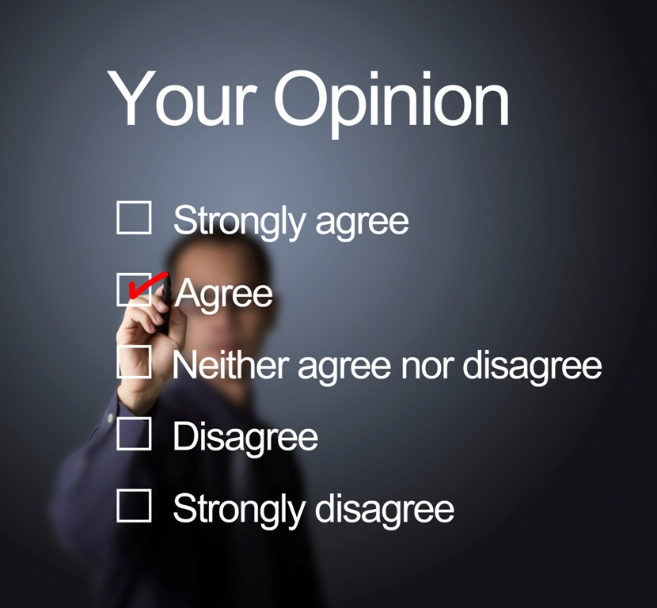


Sociological Investigation:
The General Social Survey
Sociology
Chapter 2: Sociological Investigation
Society: The Basics
Chapter 1: Sociology: Perspective, Theory, and Method
Notes:
Sources:
(1) GSS: General Social Survey website at http://www3.norc.org/GSS+Website/About+GSS/
(2) The Associated Press-NORC Center for Public Affairs Research, “General Social Survey: Chronicling Changes in American Society” March, 2015.
http://www.apnorc.org/projects/Pages/general-social-survey-chronicling-changes-in-american-society.aspx
(3) International Social Survey Programme website at http://www.issp.org/index.php
Image source: Pearson Asset Library

Slide 2
Journalists
The General Social Survey was developed more than 40 years ago to track opinions on a wide variety of key social, economic, and political issues in the United States.
Scholars
Policymakers
Students
More than 400,000 students use the GSS in their classes each year.
Notes:
Conducting surveys that provide information that represents the U.S. adult population as a whole is expensive and time consuming and requires considerable resources. The General Social Survey is among the most well-respected national surveys that provides us with information about many aspects of people’s attitudes and behavior. The General Social Survey is done by the National Opinion Research Center at the University of Chicago. The first survey was completed in 1972 and a survey has been carried out in almost every year. Since 1994, the research has been done bi-annually. Because many of the same questions are asked in each survey, we have the ability to identify trends over time. After the U.S. Census, the GSS is the most frequently-used source of social science data in the United States.

Slide 3
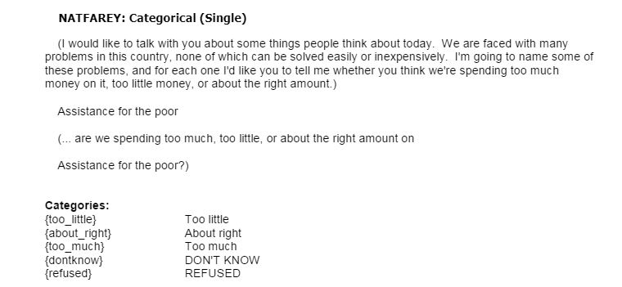
In 2014, nearly 2,500 people were interviewed in person.
The sample is nationally representative.
Many questions have not changed since 1972, enabling trend analysis.
Notes:
The fact than many variables are used allows us to identify correlations between, say, income level and political attitudes. Race and gender are available to permit multivariate analysis. Remind the class that evidence of correlation is not evidence of cause-and-effect, although researchers may find that correlations suggest possible causal relationships, subject to further study.

Slide 4
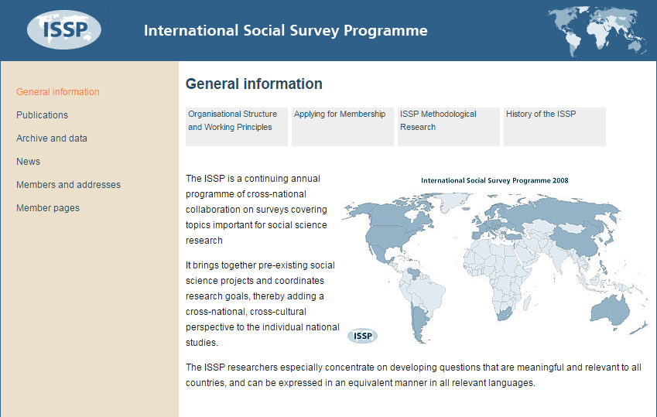
The GSS allows us to compare data cross-nationally via the International Social Survey Programme (ISSP), a consortium of 58 countries.
Notes:
The General Social Survey provides data about the U.S. population. The International Social Survey Programme (ISSP) brings together researchers from fifty-eight nations to allow cross-national analysis. Data from the GSS are available for hundreds of variables. Most high-income nations also participate in the ISSP. More than 7,100 research projects have made use of ISSP data.
Each ISSP has one or more different special topic “modules.” For 2016, the focus will be “Role of Government;” for 2017, “Social Networks and Social Resources,” and for 2018, “Religion.”
More information on the ISSP can be found here: http://www.issp.org/index.php

Slide 5
Some of the major findings in 2014…
More Americans support spending increases than budget cuts for education, halting crime, and assistance to the poor.
For the first time ever, more Americans support legalization of marijuana (52 percent) than oppose it (42 percent).
Twenty-one percent of Americans report having no religious preference, a record high, but belief that God exists remains fairly widespread (58 percent).
Notes:
The items shown on this slide suggest the practical value of GSS data. We gain a sense of where the population stands on many current issues.

Slide 6

The GSS has been part of all the editions of all the Macionis titles.
A few examples from this edition…
How much do people trust each other? (Ch. 24)
What share of women have been sexually harassed on the job? (Ch. 13)
How many people think a qualified woman could serve as president of the United States? (Ch. 3)
How many children is the “ideal number” in a family? (Ch. 18)
How many men and women have been sexually unfaithful to their partners? (Ch. 19)
Notes:
Any time you see “Smith et al.,” it is a reference to the combined dataset for the General Social Surveys since 1972. The principals at NORC are Tom W. Smith, Peter Marsden, Michael Hout, and Jibum Kim.

Slide 7
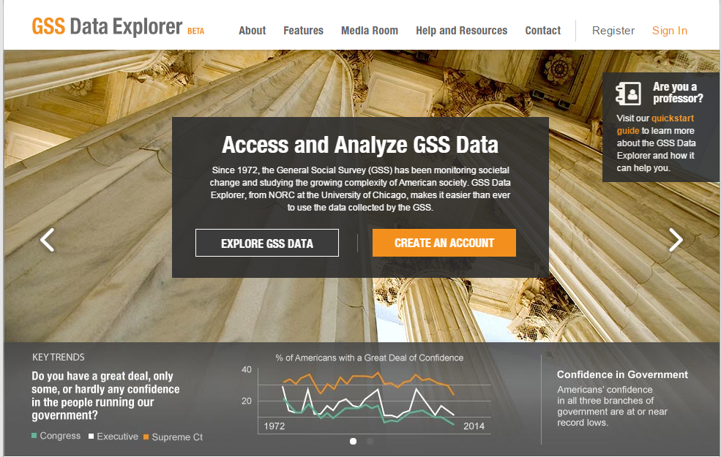
You can use the GSS data…
https://gssdataexplorer.norc.org/
Notes:
Encourage students to visit the GSS website. Data are available for anyone to explore, sparking the sociological imagination!
Note that this is a brand new site (December 14, 2015) that allows users to “explore and analyze the GSS data you need, create data visualizations, and generate custom extracts to analyze in your statistical program.”

Slide 8
Discussion Questions
Can you suggest ways in which GSS data can be used to guide social policy decisions?
The General Social Survey is an extensive source of “existing data.” Looking ahead, can you anticipate college projects that would benefit from the use of GSS data?
Notes:
Point out to the class the benefits of using high-quality national data rather than relying on a questionable sample of local subjects.

