Slide 1
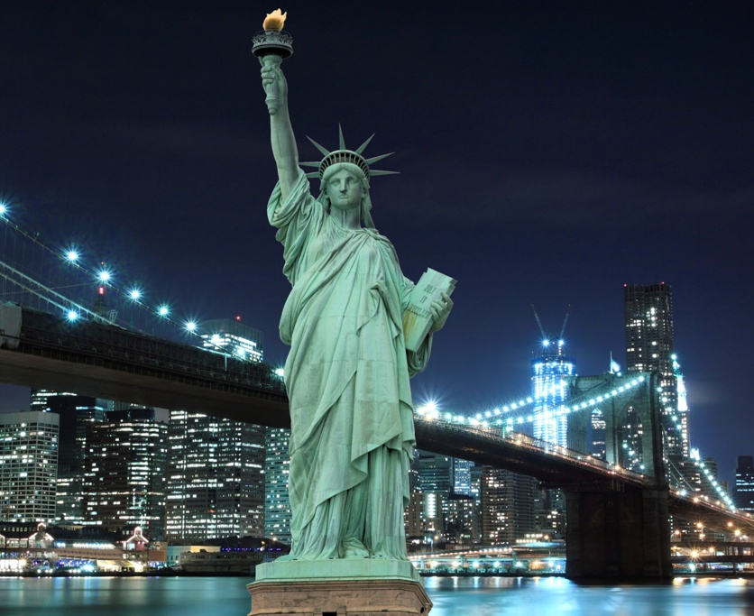

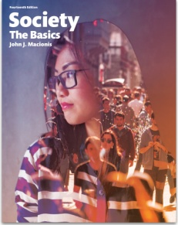
The U.S. Foreign-born Population
1860 to 2010
Sociology
Chapter 3: Culture
Society: The Basics
Chapter 2: Culture
Notes:
Source: Singer, Audrey. “Contemporary Immigrant Gateways in Historical Perspective.” Dædalus, the Journal of the American Academy of Arts & Sciences, MIT Press. Summer, 2013. http://www.brookings.edu/research/articles/2013/09/05-immigrant-gateways-singer
Author’s calculations of 1860–2000 data via Campbell Gibson and Kay Jung, “Historical Census Statistics on the Foreign-Born Population of the United States: 1850–2000,” Population Division Working Paper No. 81 (Washington, D.C.: U.S. Bureau of the Census, February 2006), http://www.census.gov/population/www/
documentation/twps0081/twps0081.html; and 2010 acs 1-year estimates, http://www.census.gov/acs/www/.
Image source: Pearson Asset Library

Slide 2
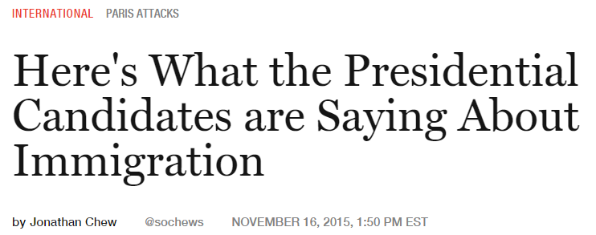
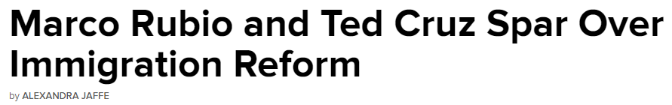

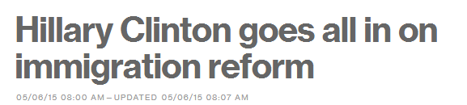
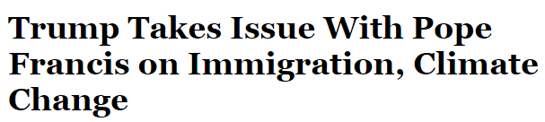
Election 2016
Notes:
European nations are now wrestling with immigration from northern African and the Middle East. The United States has had high levels of immigration for almost all of its history.

Slide 3
Election 2016
Immigration has been one of the most important issues debated throughout the 2016 presidential election...
What are some of the facts about this country’s immigration experience?

Slide 4
What patterns do you see in the number of foreign-born people in the United States over time?
Notes:
The numbers of foreign-born people increased (along with the nation’s overall population) after the Civil War up until labor unrest and political radicalism involving many foreign-born people created an anti-immigrant climate that led Congress to restrict immigration in the 1920s. The Great Depression and World War II discouraged immigration and reduced the number of foreign-born people. In the 1960s, Congress opened the country to greater immigration and the numbers of people coming to this country increased rapidly in the decades that followed.

Slide 5
The bars in this chart represent the share of the U.S. population born abroad for each decade between 1860 and 2010.
Notes:
To see the changing ethnic diversity of the U.S. population, we must see not just the size of the foreign-born population but also the share of the population born abroad. Between the Civil War and World War I, as this slide shows, that share was high—approaching 15 percent of the total. Thereafter, the share declined to below 5 percent by 1970. Then another reversal took place, with the share increasing, but not to the highest levels found in our nation’s past.

Slide 6
There are more foreign-born people in the United States than ever before.
Yet, the share of the population that is foreign-born remains below what it was during the height of what was called the “Great Immigration.”
Notes:
Many students think that there is more ethnic diversity in the United States today than ever before. These graphs show that cultural diversity has been increasing but remains below what the country experienced between 1860 and 1920.

Slide 7
Discussion Questions
How would you describe our national response to immigration? What do people point to as the benefits of our nation gaining (typically young) foreign-born people? What concerns do people express?
Do you think there is more public awareness of cultural diversity today than in the past? What part do the mass media and computer technology play in encouraging or discouraging cultural awareness?
Notes:
In general, political liberals favor open immigration in the interest of greater cultural diversity and also because immigrants tend to favor Democratic candidates. Political conservatives support immigration, evidence that the United States is a “land of opportunity,” but are cautious about increasing the rate of social change and undermining what they see as “traditional values.”

