Slide 1
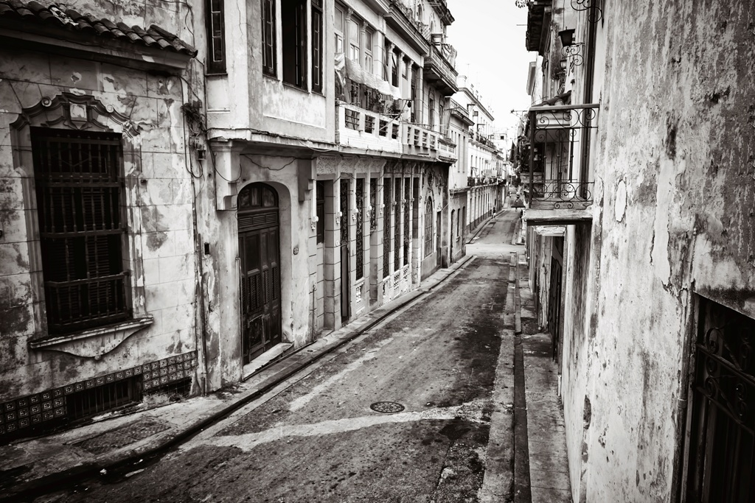



The Cuban Health Paradox
Sociology
Chapter 4: Society
Society: The Basics
Chapter 14: Education, Health, and Medicine
Notes:
Source: Sanger-Katz, Margot. “Can Cuba Escape Poverty but Stay Healthy?” New York Times, December 19, 2014.
Images: Pearson Asset Library

Slide 2
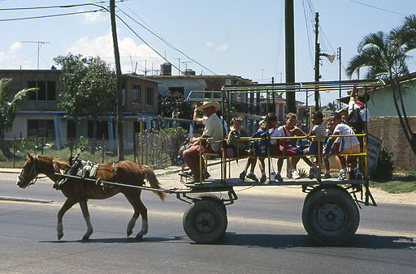
Cuba is a middle-income nation that is economically poor in relation to the United States…
In 2014, the economic output of the U.S. economy was $53,750 for every person in the country, a number that is almost three times higher than that for Cuba.
Notes:
GNI refers to “gross national income.” GNI per capita is equal to the value of country’s economic output divided by its midyear population. Cuba’s relatively low-level of economic productivity has various causes. Analysts sympathetic to the Cuba’s government-run economy point to the U.S. policy of economically isolating the island nation. Those less favorable toward Cuba’s political economy point to an inefficient economic system.
Data from GM 12-1 (World Bank, World Development Indicators, 2014)
Image: By Henryk Kotowski (Own work) [GFDL (http://www.gnu.org/copyleft/fdl.html), CC-BY-SA-3.0 (http://creativecommons.org/licenses/by-sa/3.0/) or CC BY 2.5 (http://creativecommons.org/licenses/by/2.5)], via Wikimedia Commons

Slide 3
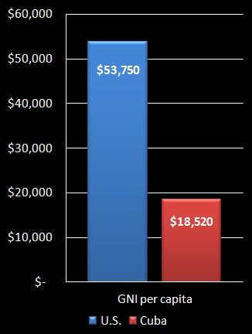
…but people there live longer than those in much richer countries…
Notes:
If health simply reflected overall economic output, Cuba would trail the United States in health indicators. However, the “paradox” is that, despite low economic productivity, the share of people who live to age sixty-five is actually greater in Cuba than in the United States. Data from GM 12-2 (United Nations, World Population Prospects, 2012 revision, 2013.)

Slide 4
…and are much less likely to die in childhood.
Notes:
Whether measured as infant mortality (the death rate in the first year of life) or the death rate under the age of five, Cuba has a lower death rate among its youngest people. This is considered to be a good indicator that Cuba’s population is healthier than that of the United States. (Data from World Bank, World Development Indicators, 2015.)

Slide 5
Why is this poor country so healthy?
Cuba has invested heavily in primary care.
Cuba has an unusually high number of doctors.
Government uses central planning to ensure that all areas of the country have enough doctors.
Health care is government-financed, so nearly every Cuban has the same access to health care.
Notes:
A number of factors explain Cuba’s favorable health patterns. The overall conclusion is that health is shaped not just by technology (Lenski’s focus) but by how resources are utilized and distributed throughout a population (Marx’s focus).

Slide 6

Why is this poor country so healthy?
Cuba has one of the highest childhood vaccination rates in the world.
Investments in public education, housing, and nutrition support good health.
Isolation and government restrictions inhibit “brain drain” to wealthier countries.
Notes:
A number of factors explain Cuba’s favorable health patterns. The overall conclusion is that health is shaped not just by technology (Lenski’s focus) but by how resources are utilized and distributed throughout a population (Marx’s focus).
Image: By Ji-Elle (Own work) [CC BY-SA 4.0 (http://creativecommons.org/licenses/by-sa/4.0)], via Wikimedia Commons

Slide 7
Discussion Questions
What do you think will happen to the country’s health as Cuba “opens up” to more liberal trade and immigration policies?
Will the quality of health decline with an inevitable increase in inequality or will improved wealth bring more advanced medical technologies to help the country grow even healthier?
What would Lenski say? What would Marx say?
Notes:
Ask students to consider what may happen to the country’s health as Cuba “opens up” to more liberal trade and immigration policies. Will the quality of health decline with an increase in inequality or will improved wealth bring more advanced medical technologies to the help the country grow even healthier? Also, there is already evidence that the recent thaw in U.S.-Cuban relations is leading some physicians to leave Cuba for the United States.
See also article on the front page of the Dec. 20, 2015 New York Times, “U.S. and Cuba at Odds Over Exodus of the Island’s Doctors.” Available here: http://www.nytimes.com/2015/12/20/world/americas/us-and-cuba-at-odds-over-exodus-of-the-islands-doctors.html

