Slide 1
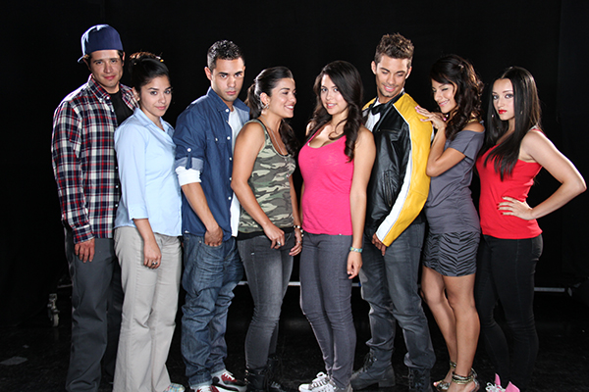

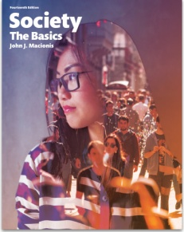
Can Mass Media Influence Behavior in a Positive Way?
Sociology
Chapter 5: Socialization
Society: The Basics
Chapter 3: Socialization: From Infancy to Old Age
Notes:
A group of media specialists at the Population Media Center in Burlington, Vermont think so. Working together with sociologists and public health officials, they are responding to the troubling fact that 51 percent of Latinas in East Los Angeles become pregnant before the age of twenty. The result of their efforts is East Los High, the critically acclaimed and very popular Hulu television series.
Sources:
Binns, Corey. “Smart Soaps: The Population Media Center mixes science with soap operas to protect public health” Stanford Social Innovation Review, Winter 2008 edition.
Donovan, Pat. “Hot Hulu web novella ‘East Los High’ spans media platforms to help young Latinos make smart choices, researchers say” University of Buffalo, July 22, 2104. http://www.buffalo.edu/news/releases/2014/07/024.html
Villareal, Yvonne. “'East Los High': A teen soap opera that's a teaching tool” Los Angeles Times, June 27, 2014. http://www.latimes.com/entertainment/tv/la-et-st-east-los-high-hulu-20140629-story.html
Image source: Populationmedia.org [https://www.populationmedia.org/2014/02/14/hulu-announces-season-two-of-east-los-high-for-summer-2014/]

Slide 2

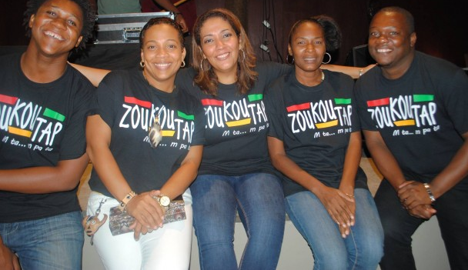
Último Año, with MTV Latin America, is shown in 18 countries.
More than 30 radio dramas are aired in Africa, Haiti, the Philippines, and Papua New Guinea.
Notes:
Population Media Center is trying to create positive change not only in the United States but around the world. The television show, Último Año, presented in partnership with MTV is shown in eighteen countries in Latin America. More than thirty radio dramas are broadcast to audiences of young adults in Haiti, across Africa, and the Philippines and New Guinea in Asia. In all cases, these programs show young people facing real-life choices about sexuality and provide role-modeling of informed choices that reduce the risks of pregnancy, sexually transmitting diseases, and domestic violence.
Image Source 1: http://entretenimiento.starmedia.com/telenovelas/elenco-nueva-telenovela-ultimo-ano.html
Image Source 2: https://www.populationmedia.org/2014/09/23/zoukoutap-en-rediffusion/

Slide 3
How does PMC create its soap operas?
Perform research on issues, laws, resources
Develop powerful stories with realistic characters and dramatic plot twists
Rely on role modeling, not dictating
Maintain high production values and cultural sensitivity.
Continually assess the perception and impact of the show.
Goal: To create social change by empowering people to make better-informed decisions.
and they use …
Notes:
Population Media Center programming is not moralistic or judgmental. Co-creator Kathleen Bedoya: “We are not passing judgment; we’re not religiously associated. We want to tell youth what their options are and let them make their own decisions. The characters decide what they want to do and viewers see the role modeling.”
“We wanted to create a place where kids could learn about sex ed and the countless other issues teens face these days,” says the online series' executive producer Katie Elmore Mota. “But you can't talk down to them and you can't make them fall asleep.”
This approach is based on the “Sabido Method,” a way of mixing entertainment and education developed in Mexico in the 1970s by Miguel Sabido.
Find more information about this strategy for change here: https://www.populationmedia.org/product/serial-dramas/

Slide 4
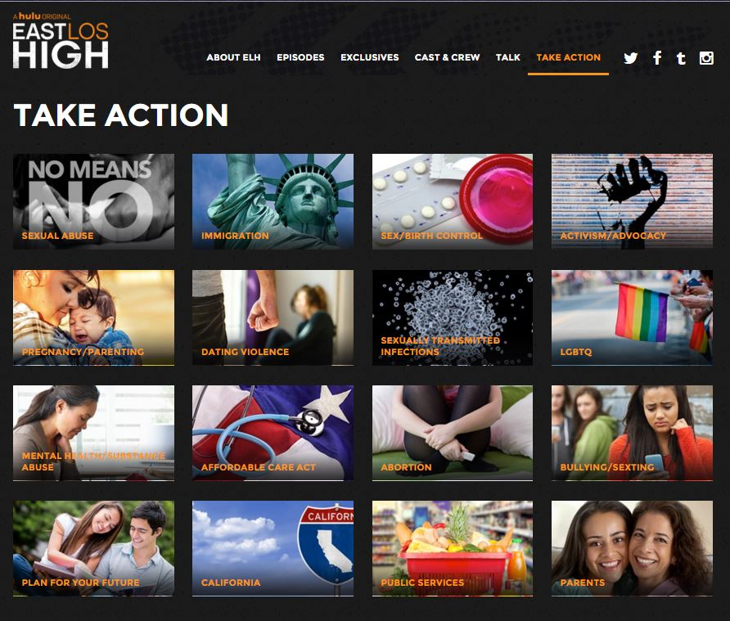
Transmedia Storytelling
Notes:
“Transmedia Storytelling” deals with a wide range of social problems. The programs draw in young viewers and show how to react to real-life situations wisely and effectively. In addition, viewers can access web sites to gain in-depth information about a wide range of issues related to sexuality and physical and mental health. Web sites
• provide information on the topics covered in the show (on slide, above).
• present the cast members’ video blogs (vlogs), done “in character”
• access to the East Los High student newspaper, The Siren (http://eastloshigh.com/thesiren/)
• offer popular recipes (veggie tacos, anyone?)
• stream the music and teach popular dances
• encourage young people to follow the show on Facebook, Twitter, Instagram, Tumblr
Trailer for Transmedia Storytelling: http://www.hulu.com/watch/502327

Slide 5
Does it work?
30,000 people used the Planned Parenthood widgets on eastloshigh.com in the first month.
76% of East Los High viewers shared web resources with friends.
In El Paso, young Latinas who watched East Los High were found to have learned valuable information about safe sex. Those women who both watched the show and visited the website learned even more.
Notes:
The evidence is that, yes, media programming can create positive change. Arvind Singhal, media specialist at the University of Texas, El Paso, conducted research using 136 young Latinas in the El Paso area who had not previously seen East Los High. Some women got reading material about safe sex, some watched the show and others watched and looked at the East Los High website. A week later, Singhal assessed their learning and discovered that those who saw the show and got on the website learned the most about condom use. Singhal explains, “The value of these programs comes from an evolving storyline, which gets audience members hooked.” Similar positive results have been found elsewhere. In Nigeria, for example, 67 percent of new health clinic clients reported seeking services because of what they had learned from the radio drama Ruwan Dare (Midnight Rain).
Sources: http://www.npr.org/2015/10/26/450294490/east-los-high-serves-up-sex-ed-with-its-teen-drama and https://www.populationmedia.org/product/serial-drama-impact/

Slide 6
Discussion Questions
Why do you think these media programs are effective in helping young people make effective choices about challenging life situations?
Do you think most mass media programming, including television and film, encourages positive or negative change in young viewers? Explain.

