Slide 1


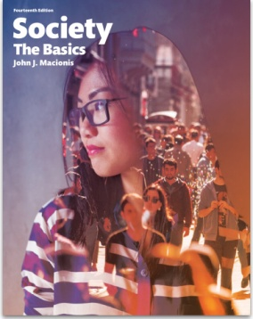
How Does the Increasing Use of Texting Affect Face-to-Face Interaction?
Sociology
Chapter 6: Social Interaction in Everyday Life
Society: The Basics
Chapter 4: Social Interaction in Everyday Life
Notes:
This is the question that Sherry Turkle has been trying to answer for the past five years. She has “looked at families, friendships and romance [and] studied schools, universities and workplaces.”
Sources:
Konrath, Sara H., Edward H. O'Brien and Courtney Hsing. “Changes in Dispositional Empathy in American College Students Over Time: A Meta-Analysis.” Personality and Social Psychology Review 15(2). 2011.
Turkle, Sherry. “Stop Googling. Let’s Talk.” The New York Times. September 26, 2015. http://www.nytimes.com/2015/09/27/opinion/sunday/stop-googling-lets-talk.html (Sherry Turkle is a professor in the program in Science, Technology and Society at M.I.T. and the author, most recently, of Reclaiming Conversation: The Power of Talk in a Digital Age.)
Photo by Garry Knight, available with CC by 2.0 license.

Slide 2

Sherry Turkle at M.I.T says it is time to “reclaim conversation for yourself, your friendships and society; push back against viewing the world as one giant app.”
Notes:
New technology is changing the character of social interaction, as it has in the past (think telegraph, telephone, television, Internet). The point is that new forms of communication do not simply replace some of the older patterns, but they also change older patterns.
Image source: Pearson Asset Library

Slide 3
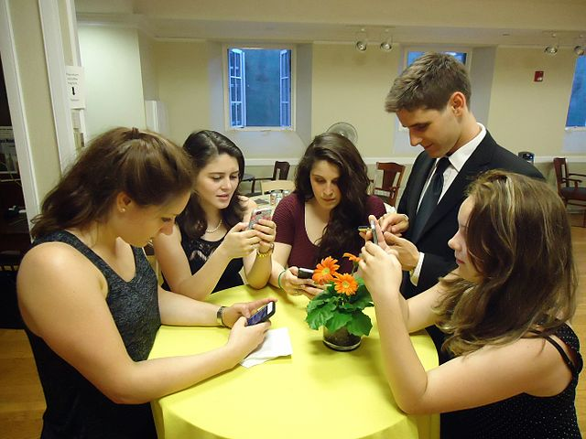
College students describe the “rule of three…”
In a conversation among five or six people at dinner, you have to check that three people are “heads up” (paying attention) before you give yourself permission to look down at your phone.
When different people have their heads up at different times, conversation is kept relatively light, on topics where people feel they can drop in and out.
Notes:
Cell phone technology has two effects: First, it draws people out of face-to-face interaction; people actually devise “rules” about phasing in and out. Second, it also shapes the content of face-to-face interaction, keeping the conversation “light” so that people can drop in and out.
Image source: “Young people texting on smartphones using thumbs" by Tomwsulcer - Own work. Licensed under CC0 via Commons (public domain; has consent of identifiable persons) - https://commons.wikimedia.org/wiki/File:Young_people_texting_on_smartphones_using_thumbs.JPG#/media/File:Young_people_texting_on_smartphones_using_thumbs.JPG

Slide 4
How new technology is shaping face-to-face interaction…
Conversation stays on topics where people won’t mind being interrupted.
More time spent on devices = less time spent engaging each other.
What is being shared in conversation? Things that are on phones.
Is this the “new conversation?”
Notes:
New technology shapes the content of interaction. It does this by keeping things “light,” and also by introducing content that people discover on screens.

Slide 5
Researchers at the University of Michigan found a 48% decrease in empathy among college students between 1979 and 2009.
Why?
Notes:
Turkle claims that cell phone technology not only changes face-to-face interaction, but that it also changes individuals at a personal level. Specifically, she posits that this technology contributes to a loss of the personal quality of empathy, the ability to understand others and share their emotional life. The longitudinal data presented here point to a significant drop in this skill over the last two generations.

Slide 6
“…one likely contributor to declining empathy is the rising prominence of personal technology and media use in everyday life.”
Online skills may not translate into smooth social relations in person.
The ease and speed of technology may lead to boredom and frustration with face-to-face interaction.
Not enough time to “reach out to others and express empathy in a world filled with rampant technology revolving around personal needs and self-expression.”
Notes:
Another possibility: Engaging in less face-to-face interaction, which is increasingly shallow, reduces our ability to learn empathy and other interactional skills. Turkle also reports that psychologists have done controlled studies involving taking away cell phones from young people in camp-like settings and finding that even a week or two without cell phones is sufficient for people to gain greater empathy skills.

Slide 7
Discussion Questions
On balance, do you share Professor Turkle’s concerns about cell phone technology? Why or why not?
In what ways, other than those noted here, do you think cell phone technology has an effect on face-to-face interaction?
Notes:
Ask the class to consider ways in which “new conversation” does the work of “old conversation” and ways in which is does not.

