Slide 1
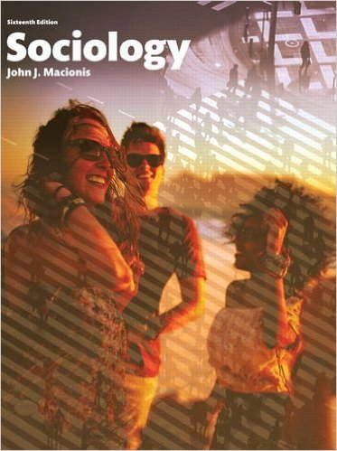
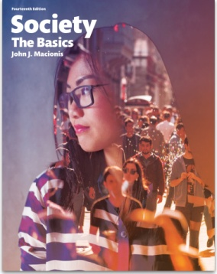
Restrooms: The Pursuit of Social Justice
Sociology
Chapter 8: Sexuality and Society
Society: The Basics
Chapter 6: Sexuality and Society
Notes:
Although the idea may seem strange to some students, one important setting in which the pursuit of social justice has played out in recent U.S. history is the public restroom. These facilities became common in the United States and elsewhere during the Industrial Revolution.

Slide 2
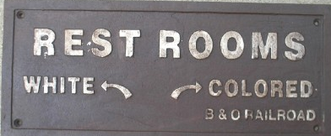
After the Civil War, public restrooms, especially in southern states, were segregated by race.
During the 1960s, this example of racial segregation gradually declined, marking a step forward in the social movement for racial equality.
Notes:
This sign, at a station along the Baltimore and Ohio railroad, directed white people and black people to different rest rooms. Racial segregation of public restrooms was a common element of the Jim Crow era following the Civil War. Racial segregation of public facilities (which included not only restrooms but waiting rooms, restaurants, hospitals, schools, and even cemeteries) declined with court decisions and the passage of the 1964 Civil Rights Act.

Slide 3
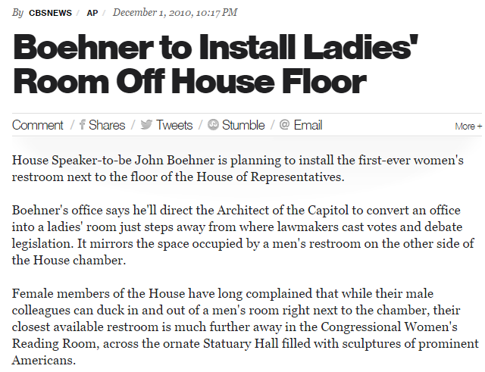
Notes:
Race is not the only dimension of social inequality that has played out in public restrooms. Gender inequality is a second example. It may surprise many people to learn that the first locally convenient restroom for women serving as members of the House of Representatives was installed as recently as 2010.

Slide 4
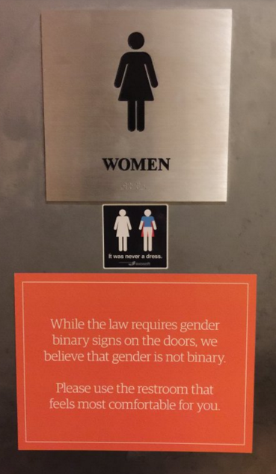
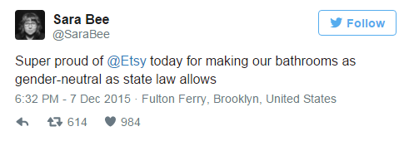
The transgender movement has directed attention to public restrooms.
Provides free choice about which bathroom people use
Challenges the binary labels that restrict access to “Women” and “Men.”
Notes:
Should people be free to choose the restroom they wish to use (whether “Men,” “Women,” or “gender neutral”)? Should public restrooms be segregated in a binary way at all?
Image from Tweet by Etsy engineer Sara Bee.

Slide 5
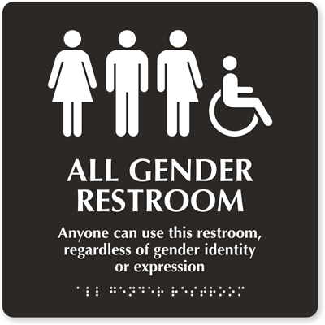
Notes:
The signs on the doors of restrooms make statements about access to public space and also about how our society understands sexuality.

Slide 6
Discussion Questions
Do you support the conventional “binary” restroom signs or not? Explain your position.
To help clarify where you stand on public restrooms, design signs that you would like to see used on your campus.

