Slide 1
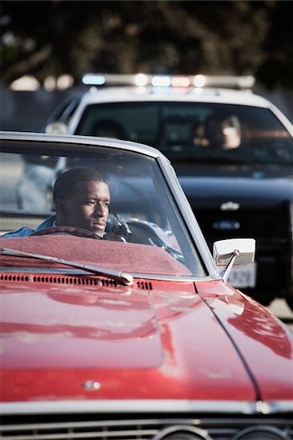
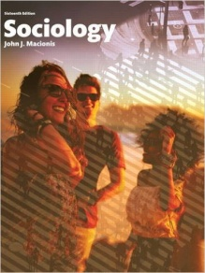
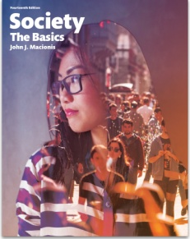
Is It Dangerous to be Black and Drive?
Sociology
Chapter 9: Deviance
Society: The Basics
Chapter 7: Deviance
Notes:
In recent years, the nation has become aware of racial bias in the operation of the criminal justice system. Specifically, police have been charged with using excessive force against unarmed African American men—leading to claims that “black lives matter.” An even more pervasive problem is the charge that police are more likely to stop and search African American motorists. But how true is this charge? Investigative reporters from The New York Times gathered official data from cities that monitor and record police behavior and reached a disturbing conclusion.
Source: Based on material in LaFraniere, Sharon and Andrew W. Lehren, “The Disproportionate Risks of Driving While Black,” The New York Times, October 24, 2015. http://www.nytimes.com/2015/10/25/us/racial-disparity-traffic-stops-driving-black.html
Image source: Masterfile (digital license)

Slide 2
Notes:
Here are data from two cities, Greensboro, North Carolina, and Chicago, Illinois. In Greensboro, police were 2.2 times as likely to stop and search an African American motorist compared to a white motorist. In Chicago, the data tell us, police were 5.2 times as likely to stop and search an African American motorist compared to a white motorist. This pattern of being more likely to stop and search black motorists compared to white motorists was found to exist in every city and state keeping these records.

Slide 3
Notes:
One possible explanation for this racial disparity is that African American motorists are more likely than white motorists to be carrying illegal drugs or weapons. So the investigators determined the likelihood that, once stopped and searched, a motorist was found to have contraband. In Greensboro, white motorists were 1.25 times as likely as black motorists to have contraband. In Chicago, white motorists were 1.4 times as likely as black motorists to have contraband. This pattern was found to exist in all but one of the cities and states providing data.

Slide 4
Notes:
Comparing the two sets of numbers, the evidence suggests that police stopping and searching African American motorists cannot be explained by a higher likelihood of contraband. It would appear that racial bias might well play a large part in police behavior.

Slide 5
Discussion Questions
Do you think this evidence supports the charge of racial bias by police?
What policies would you propose to address this concern of racial bias?

