Slide 1
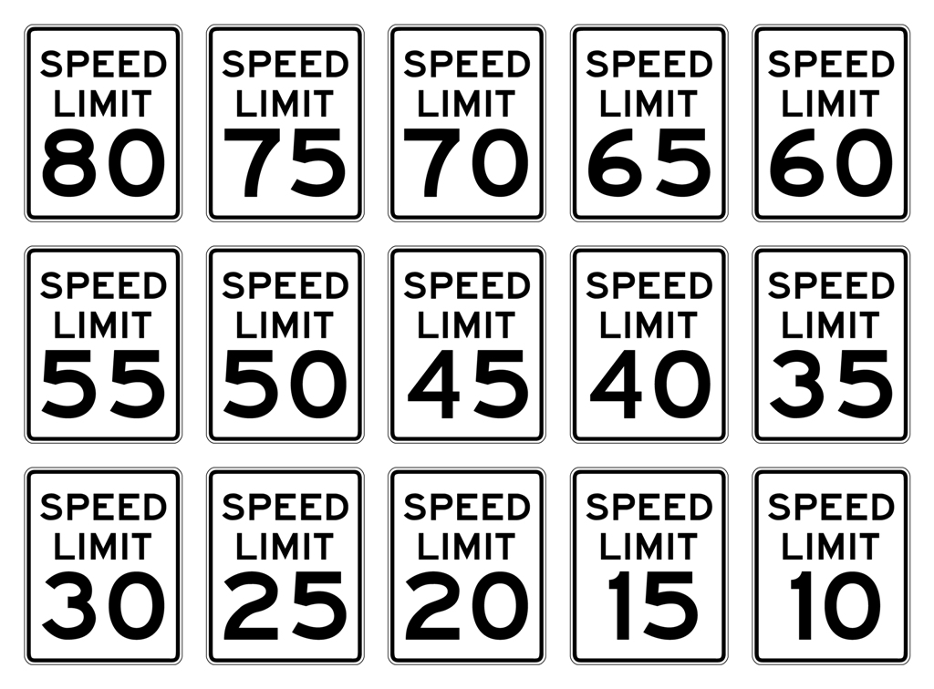


The Geography of
Car Deaths in the United States
Sociology
Chapter 10: Social Stratification
Society: The Basics
Chapter 8: Social Stratification

Slide 2
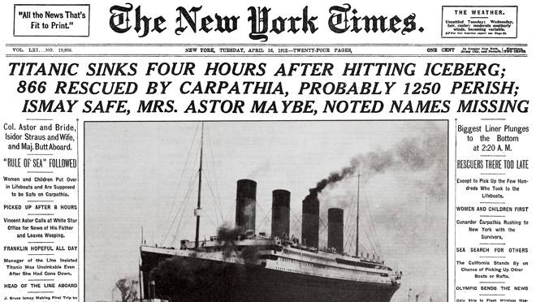
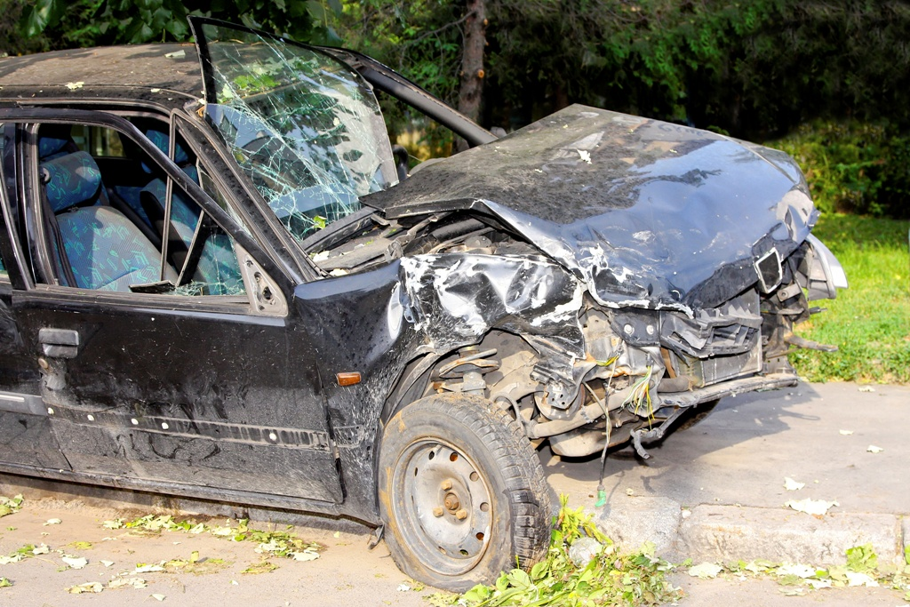
Does social class also play a part in who dies in automobile accidents?
Social class played a part in who perished in the sinking of the Titanic.
Notes:
As the story at the beginning of this chapter shows us, on the last voyage of the Titanic, social class was truly a matter of life and death. Today, a century later, on the highways of the United States, the same is true.
Using data from the National Highway Traffic Safety Administration and the Centers for Disease Control, Michael Sivak and Brandon Schoettle (University of Michigan Transportation Research Institute) published a study in 2015 that mapped the 2013 death rate from road crashes for states across the country.
The researchers claim that road deaths are largely preventable, but doing so requires knowledge of where deaths are most likely to occur and why.

Slide 3
Notes:
We begin by identifying the states with the highest rates of highway deaths. The data at the top of the bars are the numbers of road fatalities for every 100,000 people in the state’s population for 2013.
States have populations of various sizes. The use of rates allows us to compare auto deaths among states of varying population size.

Slide 4
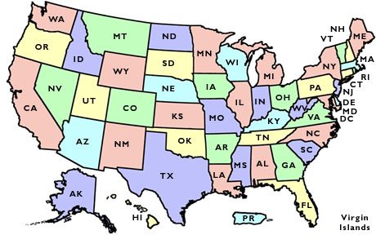
Here are the same ten states shown geographically. What patterns do you see?
Notes:
Sivak and Schoettle call the North Plains and the Deep South “America’s Car Death Belt.” The states with high auto death rates have largely rural populations. They also have relative low median family income. Students may recognize that these are generally “Red States” that voted Republican in recent presidential elections.

Slide 5
Why?
Car deaths are higher in states that ...
are less densely populated,
are more rural,
have higher speed limits,
and
that are poor.
Notes:
What traits define these “top ten” states in terms of auto fatalities? Rural highways have high speed limits, in some cases as high as 85 miles per hour. Beyond that, however, these populations are, on average, relatively poor.
The road death rate is negatively correlated with states’ per capita income (-.66). This is a strong correlation that may explain more than 40 percent (r²) of death-rate variation. Remind the class that correlation does not prove causation, but points to association between variables.

Slide 6
Consider these findings:
Rates of car deaths were higher in states with
  higher poverty rates,
  greater shares of workers in blue-collar jobs.
Rates of car deaths were lower in states with
  more high-tech knowledge-based economies,
  greater shares of adults who are college graduates.
Notes:
High auto-death states (such as Mississippi) have relatively high poverty rates and a high share of the labor force in farming and blue-collar work. The populations of these states contain a higher share of men and women who drive a lot, and they drive relatively older vehicles equipped with less crash protection and other safety technology. These people can afford less regular auto service and repair.
Low auto fatality states (such as California) have smaller percentages of people who drive automobiles, and lower speed limits and traffic congestion keep speeds down. These states have a larger share of workers in service work that requires more extensive schooling. People in these states drive vehicles that are relatively newer because people can afford them, they are able to maintain their vehicles in a better state of repair, and they drive cars that (on average) have safer tires.
Ask the class how these factors might inform future policy that would reduce the rate of auto fatalities.

Slide 7
Discussion Questions
To what extent do you think that social class position shapes not only quality of life but amount of life?
Do you think society has a responsibility to do anything about disparities such as what is described here? If so, what?
Notes:
Social class shapes both quantity and quality of life. These facts are evident in all aspects of health, from infant mortality rates to life expectancy.

