Slide 1
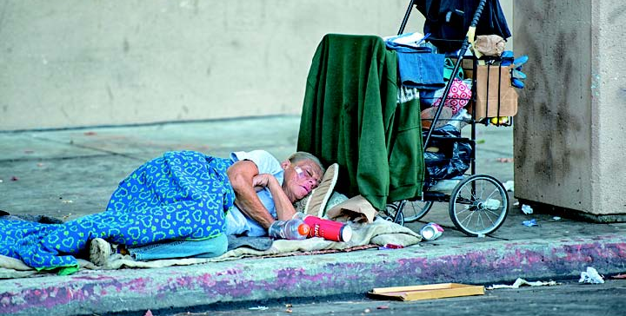


Perception of Wealth Inequality in the United States
Sociology
Chapter 11: Social Class in the United States
Society: The Basics
Chapter 8: Social Stratification

Slide 2
How much inequality do people think exists in the U.S.?
The estimates of wealth distribution were consistent regardless of gender, income level, or political party identification.
Notes:
These data resulted from research by Michael Norton (Harvard Business School) and Dan Ariely (Duke University) involving a survey of about 5,000 U.S. adults. This first pie chart is the overall result of asking people what they think is the distribution of wealth in the United States. The variation in responses among people by sex, income, and political affiliation was small.
Source: Norton, Michael I. and Dan Ariely. “Building a Better America – One Wealth Quintile at a Time.” Perspectives on Psychological Science, Vol. 6, No. 9, 2011.

Slide 3
How much inequality do people think should exist in the U.S.?
All categories, including the wealthiest, desired a more equal distribution of wealth than what they estimated the current United States level to be, and all categories also desired some inequality, even the poorest respondents.
-- Norton & Ariely, 2011
Notes:
Respondents were also asked how much inequality of wealth should exist in the United States. This second figure shows the overall response to that question. Notice that people do expect some inequality of wealth, although at a level less than what they think exists.

Slide 4
How much inequality actually exists in the U.S.?
In reality, the bottom 20% of U.S. families are in debt and the bottom 80% have barely ten cents of every dollar of wealth in the U.S.
Notes:
Now we see how much inequality of wealth actually exists in the United States. This figure corresponds to data in Figure 11-1 of Sociology and Figure 8-3 of Society: The Basics. Clearly this level of wealth inequality is greater than what people think exists and far greater than what people say should exist.
Source: Wolff, Edward N. "The Asset Price Meltdown and the Wealth of the Middle Class." New York University, August 26, 2012.

Slide 5
How do these compare?
Notes:
Here we see the three survey responses together: what people perceive, what they say is the ideal, and what is the actual situation in the United States. To help guide discussion, move on to the slides that follow.

Slide 6
How do these compare?
Notes:
One main focus of this slide is the middle class—which, here, means the three middle quintiles or the middle 60 percent of all families. People think that the middle 60 percent has 38 percent of all wealth; they say the middle 60 percent of families should have 57 percent of all wealth; the middle 60 percent of families actually have 12.5 percent of all wealth.
The other focus is the poor—the 20 percent of families with the least wealth. People perceive that the poor and near poor have 3 percent of all wealth; they say that these families should have 7 percent of all wealth; the poor and near poor actually have no wealth at all and are in debt.

Slide 7
Discussion Questions
What distribution of wealth do you find fair? What share of wealth would you give to each quintile of families?
What policies would you support to reduce economic inequality? Would you focus on “growing the economy” so average people have more economic opportunity (as Republicans tend to do) or taxing the rich and increasing government funded programs to assist lower-income people (as Democrats tend to do)? Why?
Notes:
For the second question, you might point out that the level of economic inequality appears to be far greater than most people think it should be.

