Slide 1



The “Tech Gender Gap”
Sociology
Chapter 13: Gender Stratification
Society: The Basics
Chapter 10: Gender Stratification
Notes:
Sources:
“Remarks by the First Lady at the National Science Foundation Family-Friendly Policy Rollout.” September 26, 2011. https://www.whitehouse.gov/the-press-office/2011/09/26/remarks-first-lady-national-science-foundation-family-friendly-policy-ro
Chou, Tracy. “What's the Size of Tech's Gender Gap? Visualize the Glass Ceiling in Some of the Most Influential Tech Companies.” August 18, 2015. http://women-in-software.silk.co/
Vilorio, Dennis. “STEM 101: Intro to tomorrow’s jobs.” U.S. Department of Labor, Bureau of Labor Statistics, Spring 2014. http://www.bls.gov/careeroutlook/subject/stem.htm
image: Pearson Asset Library

Slide 2

Employment in occupations related to
STEM—science, technology, engineering, and mathematics—is projected to grow to more than 9 million between 2012 and 2022.
That’s an increase of about 1 million jobs over 2012 employment levels.
Notes:
STEM—science, technology, engineering, and mathematics—is a traditionally masculine area of study and work. Because these fields lie at the heart of the new information economy, we need to ask how accessible they are to today’s women.
Image: Pearson Asset Library

Slide 3
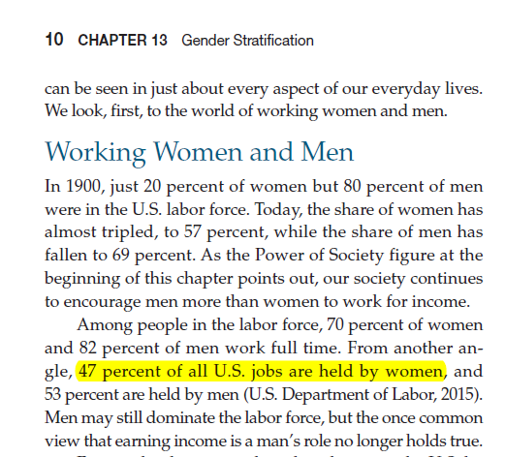
We know that women hold 47% of all jobs in the workforce. But is this true for jobs in software engineering and mathematics?
Notes:
Women not make up almost half of the total U.S. labor force, a share far higher than it was a century ago when the industrial revolution was underway. What is the situation with regard to jobs in science, technology, engineering, and mathematics?

Slide 4
Percentage of Jobs Held by Women
Notes:
The answer, in short, is that women are not well represented in these fields. Women hold only 26 percent of all tech jobs involving computer science and mathematics (excluding women who hold non-tech jobs such as clerical work in technology companies). If we look at three major tech corporations, Google, Facebook, and Twitter, we see an even lower share of tech jobs held by women.

Slide 5
In 207 major software companies, women make up, on average, 16% of the software engineering team.
Notes:
More broadly, a survey of 207 major software companies found that, on average, just 16 percent of software engineering jobs are held by women.

Slide 6
Notes:
Women who work for tech companies are likely to work in non-tech jobs, including many that traditionally are defined as feminine. Here we see the gender profile for jobs at five large and well-known tech companies. Notice that, at four of the five companies, the overall share of jobs held by women is below the national 47 percent level noted in slide 4. But when we focus on the tech jobs, the share of women in the workforce is far lower in every case.

Slide 7

“If we’re going to out-innovate and out-educate the rest of the world, then we have to open doors to everyone […] and that means clearing hurdles for women and girls as they navigate careers in science, technology, engineering and math.”
Notes:
Michelle Obama has pointed to the need to open doors in science and technology to women and girls. The evidence here suggests that there is much work to be done.
Image: Creative Commons - Attribution Licence, in accordance with the Open Government License. Source: Simon Davis/DFID

Slide 8
Discussion Questions
In what ways might parents, schools, colleges, and tech companies address this lack of women in technology jobs? Be specific about what you think needs to be done.
What change in the patterns shown here do you expect to see a decade from now? Why?

