Slide 1



Physician-assisted Dying:
Will It Become the Law of the Land?
Sociology
Chapter 15: Aging and the Elderly
Society: The Basics
Chapter 3: Socialization: From Infancy to Old Age
Notes:
Sources:
The Economist. “California’s governor has signed a bill legalising doctor-assisted dying.” October 6, 2015. http://www.economist.com/node/21671379
Gallup. “In U.S., Support Up for Doctor-Assisted Suicide.” May 27, 2015. http://www.gallup.com/poll/183425/support-doctor-assisted-suicide.aspx
Ollove, Michael. “More States Consider 'Death With Dignity' Laws.” The Pew Charitable Trusts, March 9, 2015. http://www.pewtrusts.org/en/research-and-analysis/blogs/stateline/2015/3/09/more-states-consider-death-with-dignity-laws
U.S. Census Bureau. QuickFacts. 2015. http://www.census.gov/quickfacts/table/PST045215/06,50,53,41,000
Image from Pearson Asset Library

Slide 2

October 5, 2015
California Governor Jerry Brown signed a bill making it legal for physicians in California to prescribe, with appropriate safeguards, lethal drugs that terminally ill patients can use to end their own lives if they so choose.
Notes:
Physician-assisted suicide is an issue of increasing importance, especially as the share of the U.S. population in old age continues to rise. The passage of legislation allowing for physician-assisted suicide is a major advance for this movement and we might well ask (in light of the rapid embrace of same-sex marriage nationwide) if such laws will soon exist across the country.

Slide 3
U.S. Population in States with Legal Physician-Assisted Dying
52 million represents one in six U.S. citizens
Notes:
Here is a brief history of states enacting physician-assisted dying laws. As of 2015, with California enacting such a law, more than 50 million people in the United States (one-in-six) lives in a state permitting physician-assisted dying.

Slide 4
In addition to California, bills on aid-in-dying were introduced in 2015 in:
Alaska
Colorado
Connecticut
District of Columbia
Hawaii
Iowa
Kansas
Maryland
Massachusetts
Missouri
New Jersey
New York
Oklahoma
Wisconsin
Wyoming
Utah
Notes:
By the end of 2015, similar bills had been introduced in the legislatures of sixteen additional states.

Slide 5
Survey Question: When a person has a disease that cannot be cured, do you think doctors should be allowed by law to end the patient’s life by some painless means if the patient and his or her family request it?
Gallup, 2015
Notes:
Survey research confirms that a majority of U.S. adults support physician-assisted dying. The results in other high-income countries are similar. In a 2015 poll by The Economist and IPSOS Mori, in 13 of 15 countries surveyed, more than half of online adults say that doctor-assisted dying should be legal. The exceptions were Poland (48% “legal” and 29% not), and Russia, (47% “legal” and 32% not).
Belgium (86%) has the highest proportion of people saying that doctor-assisted dying should be legal, followed by France (84%) and the Netherlands (81%). In Great Britain 70% of people say that it should be legal, while 13% say it should not be legal.

Slide 6
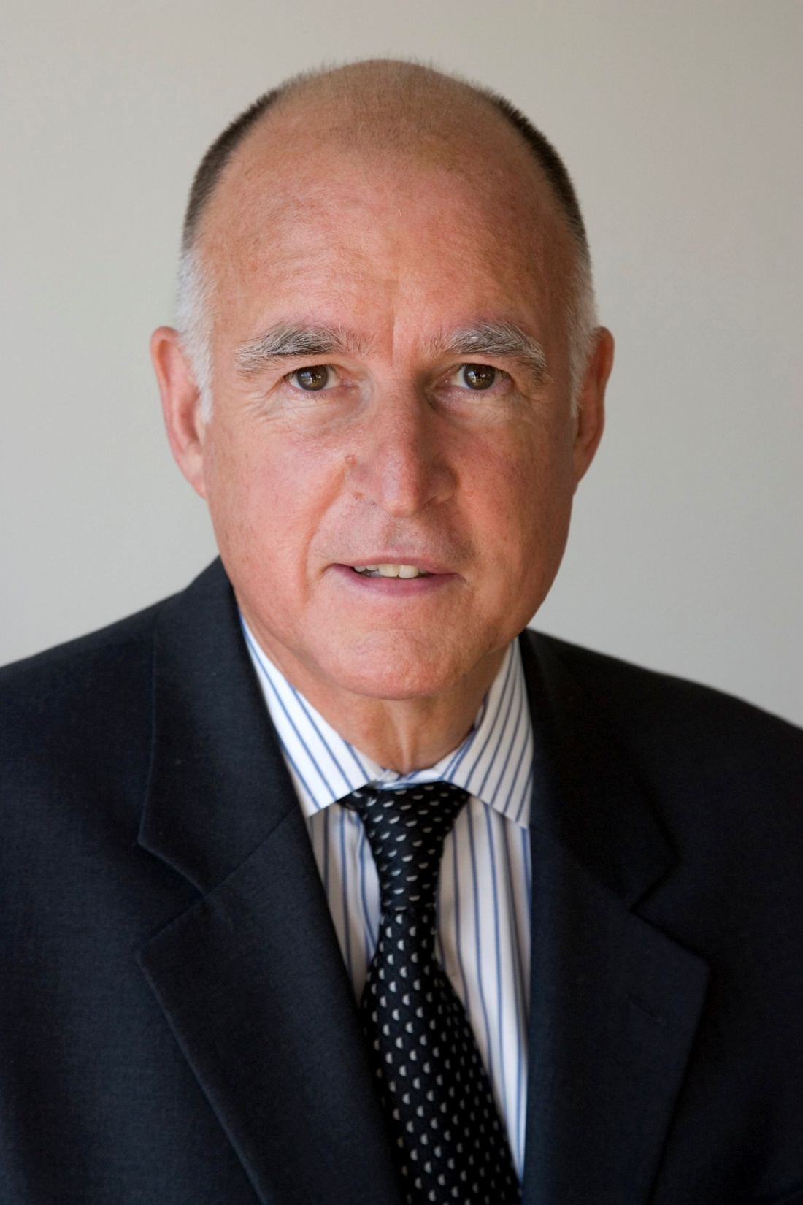
Governor Brown:
I do not know what I would do if I were dying in prolonged and excruciating pain. I am certain, however, that it would be a comfort to be able to consider the options afforded by this bill. And I wouldn’t deny that right to others.
Notes:
Photo: Public domain [https://www.gov.ca.gov/m_about.php]

Slide 7
Opponents claim that the effect of the law on well-off, well-educated people such as Gov. Brown is less the point than the impact on less privileged people, especially the elderly, who “might find themselves under pressure from relatives or health-care providers to take a quick and cheap way out.”
Supporters reject that as paternalistic, claiming that there is no evidence from Oregon or other states to suggest that people take their own lives under duress.
Notes:
Opponents of physician-assisted dying claim that such laws create a “slippery slope” by which people who are depressed may decide to take their own lives with a doctor’s help. Or patients may be aware that expensive end-of-life care can deplete resources that other family members think should remain for heirs. Supporters of these laws respond that there is no substantial evidence that either of these concerns is well founded.

Slide 8
Discussion Questions
Do you support the idea that people have a “right to die” with the help of a physician? Why or why not?
What do you expect to be the future of such legislation across the country?

