Slide 1
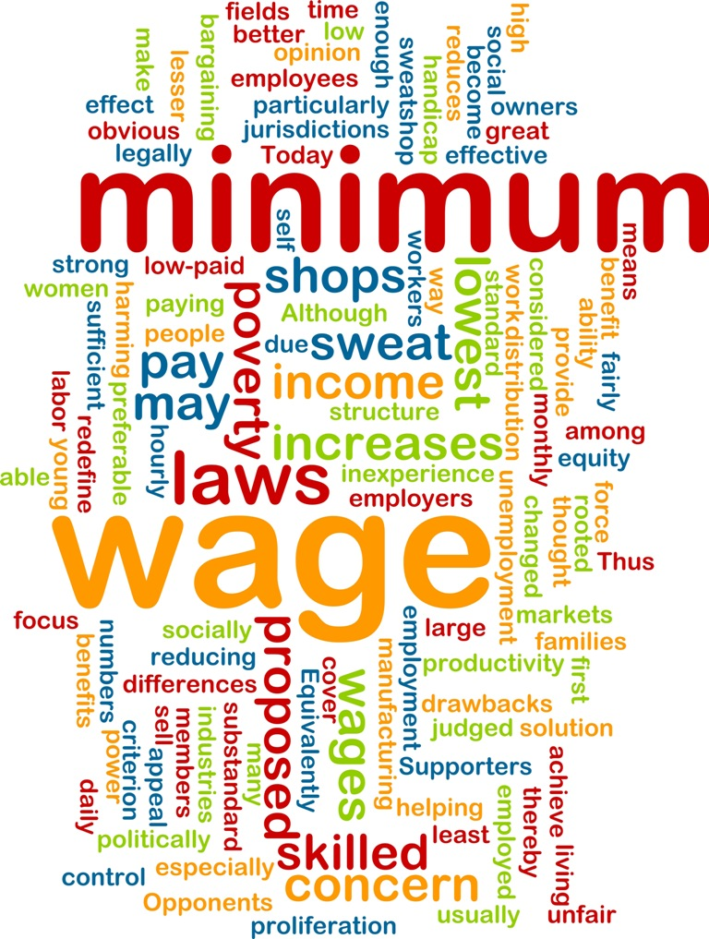
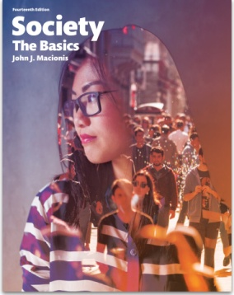
Should We Raise the Minimum Wage?
Sociology
Chapter 16: The Economy and Work
Society: The Basics
Chapter 12: Economics and Politics
Notes:
Sources:
DeSilver, Drew. “5 facts about the minimum wage.” Pew Research Center, July 23, 2015. http://www.pewresearch.org/fact-tank/2015/07/23/5-facts-about-the-minimum-wage/
“Pay Dirt.” The Economist, May 20, 2015. http://www.economist.com/blogs/graphicdetail/2015/05/minimum-wages
Los Angeles Times, May 19, 2015; New York Times, July 22, 2015.
Pew Research Center, “Most See Inequality, but Partisans Differ Over Solutions.” January 23, 2014. http://www.people-press.org/2014/01/23/most-see-inequality-growing-but-partisans-differ-over-solutions/
U.S. Bureau of Labor Statistics, “Characteristics of Minimum Wage Workers, 2014.” April, 2015. http://www.bls.gov/opub/reports/cps/characteristics-of-minimum-wage-workers-2014.pdf

Slide 2
In inflation-adjusted dollars, the minimum wage in the U.S. peaked in 1968.
Notes:
The first minimum wage law was enacted in 1938, which provided for minimum pay of 25 cents an hour, which would be 3.45 in 2014 dollars (controlled for inflation). Historically, the value of the minimum wage reached a peak in 1968 (at $1.60 or $8.54 in 2014 dollars). At the beginning of 2016 the federal minimum wage was $7.25, although most states and many cities have enacted higher minimums.

Slide 3
The Economist (2015)…
The United States “is an outlier among advanced economies.”
and
If the U.S. were similar to other high-income countries, minimum wage would be “around $12 an hour. That would mean a raise of about 65% for Americans earning the minimum pay rate.”
Notes:
In global perspective, the United States provides a lower minimum wage than other high-income nations.

Slide 4
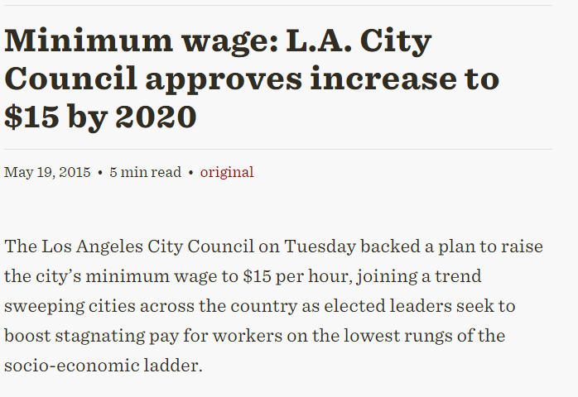
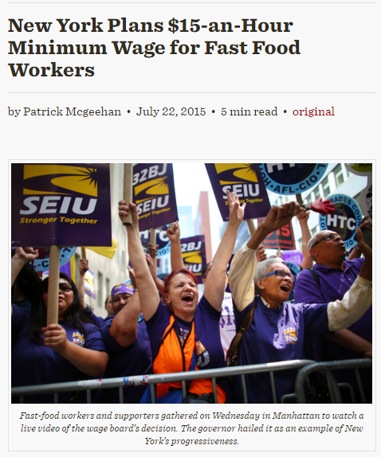
As of July 2015, 29 states, the District of Columbia, and more than 25 cities and counties have set minimum wage above the $7.25 federal level.
Notes:
A majority of states and a number of large cities have enacted or will soon enact minimum wages levels above the federal standard.

Slide 5
Who earns minimum wage?
About 3 million workers in the United States
48% are under the age of 25
63% are women
37% are African American, Asian American, or Hispanic American
Notes:
Some 3 million U.S. workers are affected by minimum wage laws. They are disproportionately young, women, and minorities.

Slide 6
In 2014, 73% of U.S. adults were in favor of raising the minimum wage…
But
Notes:
Surveys indicate that a majority of U.S. adults favor a higher minimum wage. Support for increasing the minimum wage is highest among Democrats (90%); but a slight majority of Republicans also favor the increase.

Slide 7
Discussion Questions
What is your view: Do you support a higher minimum wage or not? Why?
What arguments are made in favor of and in opposition to a higher minimum wage?
Notes:
Supporters of a higher minimum wage point to the need for a “living wage” that will support a family. People who work hard should be able to live on what they earn. Opponents claim that increasing the cost of labor will reduce demand for labor and raise the employment rate. They claim that the minimum wage is largely given to entry-level workers who move to a higher wage level over time.

