Slide 1

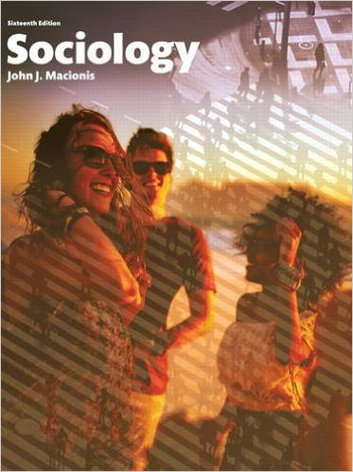
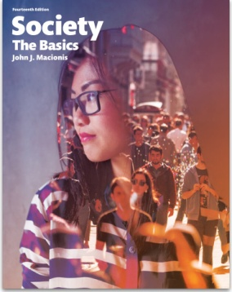
Millennials: Social Media and Political Polarization… or Not?
Sociology
Chapter 17: Politics and Government
Society: The Basics
Chapter 12: Economics and Politics
Notes:
Sources:
(1) “How social media influences Millennials’ political views.” Harvard Kennedy School Shorenstein Center on Media, Politics, and Public Policy. Last update December 3, 2015. http://journalistsresource.org/studies/society/social-media/facebook-millennial-politics-election
Media Insight Project. “How Millennials Get News: Inside the habits of America’s first digital generation.” American Press Institute and the Associated Press-NORC Center for Public Affairs Research. March 16, 2015. http://www.americanpressinstitute.org/publications/reports/survey-research/millennials-news/
Douglas, Sara, Roxanne B. Raine, Misa Maruyama, Bryan Semaan, Scott P. Robertson. “Community matters: How young adults use Facebook to evaluate political candidates.” Information Polity, vol. 20, no. 2,3, pp. 135-150, 2015.
Tuschman, Avi. “Why Americans Are So Polarized: Education and Evolution.” The Atlantic, February 28, 2014. http://www.theatlantic.com/politics/archive/2014/02/why-americans-are-so-polarized-education-and-evolution/284098/

Slide 2
Millennials are …
less likely to be affiliated with religion,
more likely to be politically independent,
the most diverse and educated generation in U.S. history,
the largest generation in the U.S. labor force,
the first generation to grow up with the Internet, cell phones, smart phones, and tablets.
Notes:
People in the “Millennial Generation” were born between 1981 and 1997. This cohort is often included in a “Generation Y,” which includes people born in the mid-2000s.

Slide 3
Notes:
Studies find that Millennials are both knowledgeable and engaged in political events. Unlike older cohorts, however, Millennials do not “watch the news” at specific times. Rather, they absorb news as they use social media, participate in social networks, and carry out their work and civic activity.

Slide 4
88%
of Millennials get news from Facebook regularly; more than half do so daily.
Facebook was the most-cited “gateway” to news for 20 of 24 separate news and information topics.
Older Millenials use an average of 3 social networks; younger Millennials an average of 4.
Notes:
Millennials make extensive use of social media, especially Facebook. Researchers found that older people in this cohort are more engaged with Facebook than younger people, who tend to use a larger number of social media sites and change them more frequently.

Slide 5
But do these behaviors have a polarizing effect?
Notes:
One question researchers asked is whether or not Millennials are becoming more polarized politically. On this point, as the following slides indicate, research does not support a clear conclusion. In other words, some evidence suggests that using social media encourages taking more left or right opinions. But other research suggests that social media are varied enough to expose young people to a range of political positions, perhaps even more than older cohorts.

Slide 6

Some evidence suggests that obtaining news via social media creates a polarizing “filter bubble.”
When college students viewed the Facebook pages of political candidates…
…they tended to base their opinions of the candidates on Facebook “community-based cues.”
…they read the comments to gauge others’ opinions of the candidates as well as to see how candidates responded to and interacted with citizens.
Notes:
For research that supports this position, see
(1) Douglas, Sara, Roxanne B. Raine, Misa Maruyama, Bryan Semaan, Scott P. Robertson. “Community matters: How young adults use Facebook to evaluate political candidates.” Information Polity, vol. 20, no. 2,3, pp. 135-150, 2015.
(2) Flaxman, Seth and Goel, Sharad and Rao, Justin M., Ideological Segregation and the Effects of Social Media on News Consumption (December 4, 2013). Available at SSRN: http://ssrn.com/abstract=2363701 orhttp://dx.doi.org/10.2139/ssrn.2363701

Slide 7
Other studies conclude that “bumping into” news via social media widens the perspectives to which Millennials are exposed.
70% of Millennials say that their social media feeds are comprised of “diverse viewpoints evenly mixed between those similar to and different from their own.”
And 73% of those investigate others’ opinions at least some of the time — with a quarter saying they do it always or often.
Notes:
For research that supports this position, see
(1) Media Insight Project. “How Millenials Get News: Inside the habits of America’s first digital generation.” American Press Institute and the Associated Press-NORC Center for Public Affairs Research. March 16, 2015. http://www.americanpressinstitute.org/publications/reports/survey-research/millennials-news/

Slide 8
Discussion Questions
To what degree do social media shape your political attitudes? Explain.
Do you think social media broaden people’s political perspectives? Or do you think social media contribute to political polarization?
Notes:
In 2012, young people supported Obama over Romney by 67 percent to 30 percent, a margin that probably helped Mr. Obama carry a number of key states, including Ohio, Pennsylvania, Virginia, and Florida. So millennials do lean Democratic. At the same time, only about half of these people voted.

