Slide 1
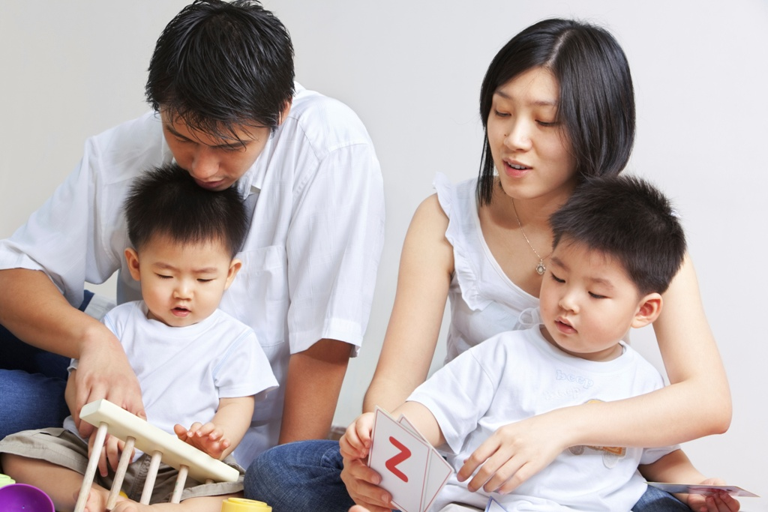


China Adopts a Two-child Policy:
What Does It Mean for Families?
Sociology
Chapter 18: Families
Society: the Basics
Chapter 13: Family and Religion
Notes:
Sources:
Buckley, Chris. “China Ends One-Child Policy, Allowing Families Two Children.” The New York Times. October 29, 2015. http://www.nytimes.com/2015/10/30/world/asia/china-end-one-child-policy.html
Kuhn, Anthony. “As China Lifts One-Child Policy, Many Chinese Respond With Snark.” NPR. November 2, 2015. http://www.npr.org/sections/parallels/2015/10/30/453072703/as-china-lifts-one-child-policy-many-chinese-respond-with-snark
Population Reference Bureau. “China Abandons One-Child Policy.” October 2015. http://www.prb.org/Publications/Articles/2015/china-ends-onechild-policy.aspx
Tatlow, Didi Kirsten. “Costs, Not Just Law, Deterred Chinese Couples From Another Child.” The New York Times. October 29, 2015.
Tatlow, Didi Kirsten and Vanessa Piao. “Ending of One-Child Policy Takes Chinese to Social Media, and Some to the Bedroom.” The New York Times. October 29, 2015.
Xinhua. “Across China: Second-child policy likely to put women at disadvantage in job hunting.” November 19, 2015. http://news.xinhuanet.com/english/2015-11/19/c_134833551.htm

Slide 2
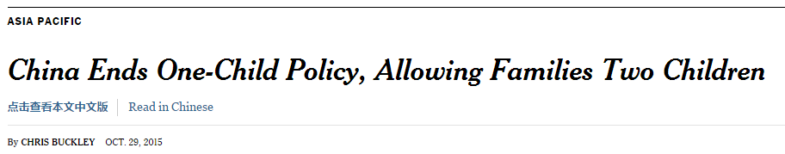
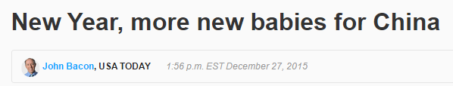
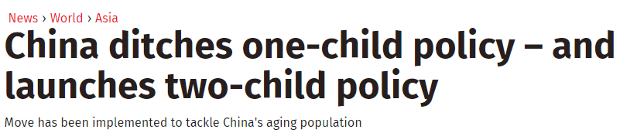
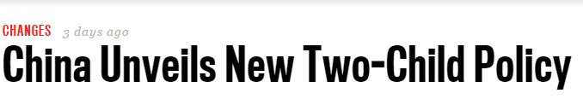
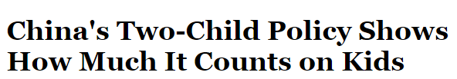
Notes:
Controlling population size has been a major concern for China, which has experienced rapid increases and now has almost 1.4 billion people. In 1980, in response to this concern, China enacted a one-child policy by which the government limited families to one child.

Slide 3

As of January 1, 2016, “one couple shall be allowed to have two children” in China, ending the one-child law that had been in effect since 1980.
"Relaxation of the family planning policy is expected to provide part of the solution to the challenge of an aging population, and to become a new driver for the economy in the long run."
Notes:
At the beginning of 2016, China relaxed the one-child policy, permitting families to have one or two children. As China has developed economically, its population is aging and, looking ahead, China will need more young people (working) to support more older people (in retirement).

Slide 4
Two-Child Policy
Demographic
Impact
Impact on Economic Growth
Impact on the Family
Notes:
China’s government control of family size will have three major consequences: affecting population size, stimulating future economic growth, and affecting family dynamics in various ways.

Slide 5
Most studies show that the new policy is unlikely to generate a large “baby boom,” nor will there be significant economic benefits, at least not for many years.
Notes:
Projections suggest that allowing families to have two children will not have a major demographic impact. Under a one-child policy, China’s population was expected to decline slightly by 2050. Under a two-child policy, it is projected to show a very slight increase.

Slide 6

While some welcome this new policy, most Chinese who are starting families were born after the “one-child law” was established; they grew up as only children themselves...
… and are reluctant to have a second child.
Notes:
The fact that families now can have a second child does not mean that most will have a second child. The one-child policy was in place for thirty-five years and has become part of the culture of family life.

Slide 7

Some couples cite the expense of raising children in China today…
A middle-class family with both partners working earns about $3,900 a month.
    A private kindergarten alone takes 15% of their combined income.
    As one mother said, “…for working mothers, there’s nothing. Who looks after your baby? A nanny is a very, very big cost.”
Notes:
Having more young people is expected to help China’s economy grow. But, from a family point of view, having a second child means greater expenses for working parents.

Slide 8

Others cite the pressures of raising children in a highly competitive society…
“Speaking of a second child, I don’t think I’ll have one […] It’s better to have one and give her the best education.”
Notes:
During the one-child era, parents focused all their attention and economic resources on a single child. Some parents now feel that dividing their cultural and economic capital between two children will put both of them at a competitive disadvantage.

Slide 9
Some women feel that this policy will make it even more difficult to compete with men in the job market…
"One interviewer told me that I am qualified but declined for the job […] with women soon to be able to have a second child, they will face more work-life balance problems. Employers just don't want to hire women.“
Notes:
Wang Qing, graduate of Jilin University
There is also a question of how having more children will affect the social position of women. For one thing, some women can expect to take more time away from work. All women may face concerns on the part of potential employers that they will have to balance workplace and home responsibilities.

Slide 10
There have been objections to China's “one-child policy” as an affront to personal freedom, and many feel the same way about this new policy…
"After decades of being forced not to have children," one woman asked, "will the government now force us to have children?"
Notes:
There is also the moral and political question of how much control government should have over the family choices people make. Some countries have no official policy on family size, some provide incentives to have (or not have) children. China has enacted specific policies limiting family size.

Slide 11
Discussion Questions
To what extent do you support China’s government regulation of family size? Explain your view.
In what ways does the government of the United States encourage or discourage people in terms of having children?
Notes:
Parents in the United States, like their counterparts in China, feel the costs of raising additional children. The federal government provides tax incentives that offset some of this cost.

