Slide 1
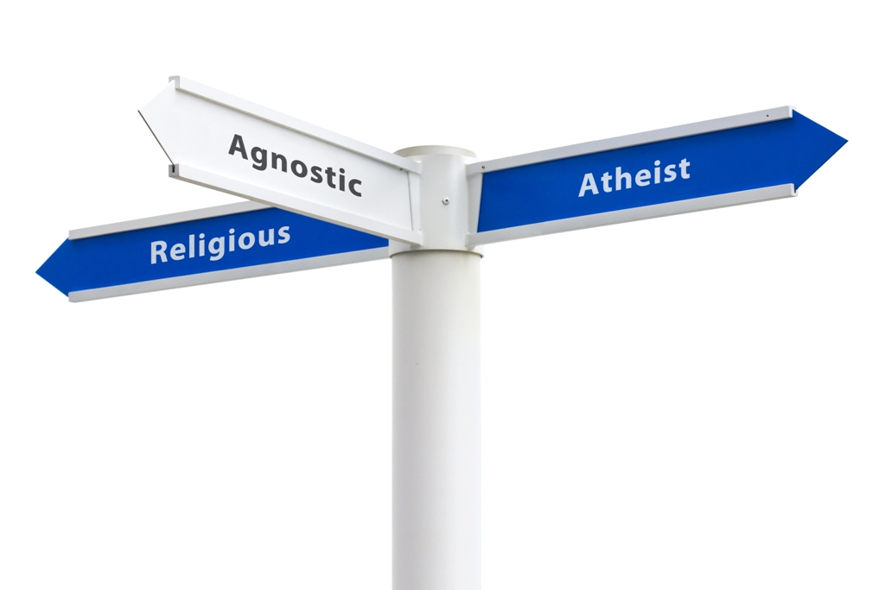

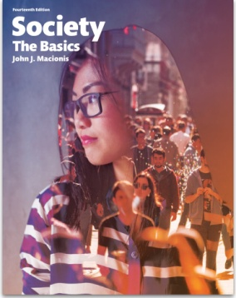
The Pew Religious Landscape Study:
Five Key Findings About Religion in the United States
Sociology
Chapter 19: Religion
Society: The Basics
Chapter 13: Family and Religion
Notes:
In 2015, the Pew Research Center released the results of a new Religious Landscape of the United States. Researchers used a very large sample size (more than 35,000 people) so that the data would provide accurate information about relatively small religious groups as well as for all states and metropolitan areas.
Source: Pew Research Center. “America’s Changing Religious Landscape.” May 12, 2015. http://www.pewforum.org/files/2015/05/RLS-08-26-full-report.pdf
Source: Pew Research Center. “America’s Changing Religious Landscape.” May 12, 2015. http://www.pewforum.org/files/2015/05/RLS-08-26-full-report.pdf

Slide 2
Why is this study important?
The U.S. Census does not ask Americans about their religion, so there are no official government statistics on the religious composition of the U.S.
Records from religious denominations use widely differing criteria for membership and sometimes do not remove members who have fallen away.
Surveys of the general public that do include questions about religious affiliation have general questions and small sample sizes.
Notes:
This study is important because other good sources of religious survey data simply do not exist.

Slide 3
The percentage of Christians in the United States continues to decline.
Notes:
One trend is the declining share of U.S. adults who identify with some denomination included within Christianity. Despite a decline of about 1 percent each year, the United States is still overwhelmingly Christian and remains home to more Christians than any other country in the world.

Slide 4
The declines among Catholics and mainline Protestants have been larger than that among evangelical Protestants.
Notes:
The decline in the share of people identifying with Christianity is greater for “mainstream” denominations than it is among evangelicals. “Mainline” Protestant denominations (including, as examples, Episcopalians and Presbyterians) show the greatest decline; Catholics a smaller decline; Evangelicals a slight decline (probably within the margin of error).

Slide 5
The share of people with no religious affiliation continues to rise.
Notes:
A second trend is an increasing share of people who say they do not identify with any religious organization. This share has been increasing by about 1 percent each year. Of the 22.8 percent of people who claim not to identify with any religion, most (18 percent of U.S. adults) said they were raised with a religious affiliation.

Slide 6
These trends apply to all demographic categories (age, sex, race, ethnicity, education) but are most pronounced among men and younger adults.
Notes:
A slightly larger share of men (20 percent) than women (19 percent) claim no religious affiliation, (up from 13 percent in 2007). The younger adults are, the larger the share who claim no religious affiliation.

Slide 7
There has been a modest increase in the share of adults who identify with non-Christian faiths.
Notes:
One exception to the trend away from organized religion is an increasing share of adults who identify with non-Christian religions. This share increased from 4.7 percent in 2007 to 5.9 percent in 2015. The Hindu share of the U.S. population has almost doubled during this time period (from 0.4 percent to 0.7 percent) and the Muslim share of the U.S. population has more than doubled (from 0.4 percent to 0.9 percent).

Slide 8
Discussion Questions
What about the importance of religion in your life and in the lives of family members? What patterns or trends do you see?
What are your predictions about the long-term strength of religion in the United States? What will be the level of religious affiliation fifty years from now? Explain your thoughts.
Notes:
The data in this study do provide support for the secularization thesis, as the share of non-affiliated people is increasing. Note also the increasing diversity of religious affiliation as, for example, the share of Hindus and Muslims increases.

