Slide 1
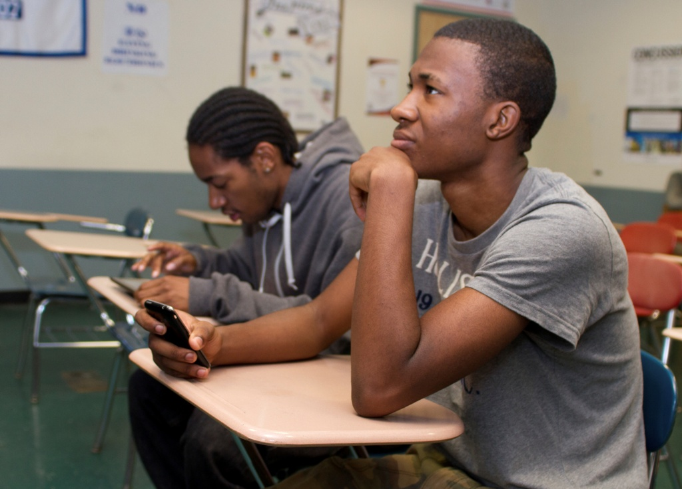
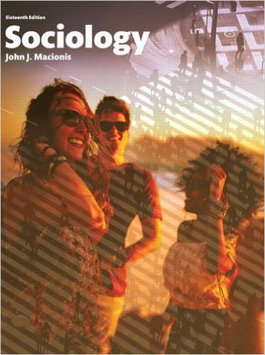
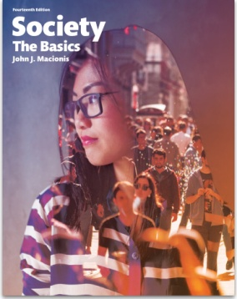
Cell Phones in Class
Sociology
Chapter 20: Education
Society: The Basics
Chapter 14: Education, Health, and Medicine
Notes:
Sources:
Duncan, Douglas K., Angel Hoekstra, and Bethany Wilcox. “Digital Devices, Distraction, and Student Performance: Does In-Class Cell Phone Use Reduce Learning?” Astronomy Education Review, Vol. 11, No. 1. 2012. Available at https://www.researchgate.net/profile/Angel_Hoekstra/publication/258562582_Digital_Devices_Distraction_and_Student_Performance_Does_In-Class_Cell_Phone_Use_Reduce_Learning/
Duncan, Douglas. “Put Your Phone Down Please: Digital Devices and Student Performance.” Digital Commons@University of Nebraska – Lincoln. November 1, 2013. Available at digitalcommons.unl.edu/cgi/viewcontent.cgi?article=1045
Kamenetz, Anya. “How to Get Students to Stop Using Their Cellphones in Class.” NPR, November 10, 2015. Available at http://www.npr.org/sections/ed/2015/11/10/453986816/how-to-get-students-to-stop-using-their-cellphones-in-class
Lepp, Andrew, Jacob Barkley, and Aryn Karpinski. “The Relationship Between Cell Phone Use and Academic Performance in a Sample of U.S. College Students.” Sage Open, February 19, 2015. Available at http://sgo.sagepub.com/content/5/1/2158244015573169
Lepp A., Barkley J. E., Sanders G. J., Rebold M., Gates P. (2013). The relationship between cell phone use, physical and sedentary activity, and cardiorespiratory fitness in a sample of U.S. college students. International Journal of Behavioral Nutrition and Physical Activity, 10, Article 79. Retrieved from http://www.ijbnpa.org/content/10/1/79
Smith, Aaron, Lee Rainie, and Kathryn Zickuhr. “College Students and Technology.” Pew Research Center, July 19, 2011. Available at http://www.pewinternet.org/2011/07/19/college-students-and-technology/.
Thomason, Andy. “Instructors, What’s the Oddest Thing You’ve Seen a Student Looking At in Class?” The Chronicle of Higher Education, January 6, 2016. http://chronicle.com/blogs/ticker/instructors-whats-the-oddest-thing-youve-seen-a-student-looking-at-in-class/107681

Slide 2
96%
of undergraduate students own a cell phone.
300
minutes is the amount of time an average student spends on a cell phone each day.
88%
of the use is for leisure.
Notes:
Cell phones are almost everywhere in the United States. Across the country, 90 percent of adults own a cell phone. The share for college students is even higher: 96 percent. Students spend an average of five hours using a phone (for calls, internet, texting and other uses) each day.

Slide 3
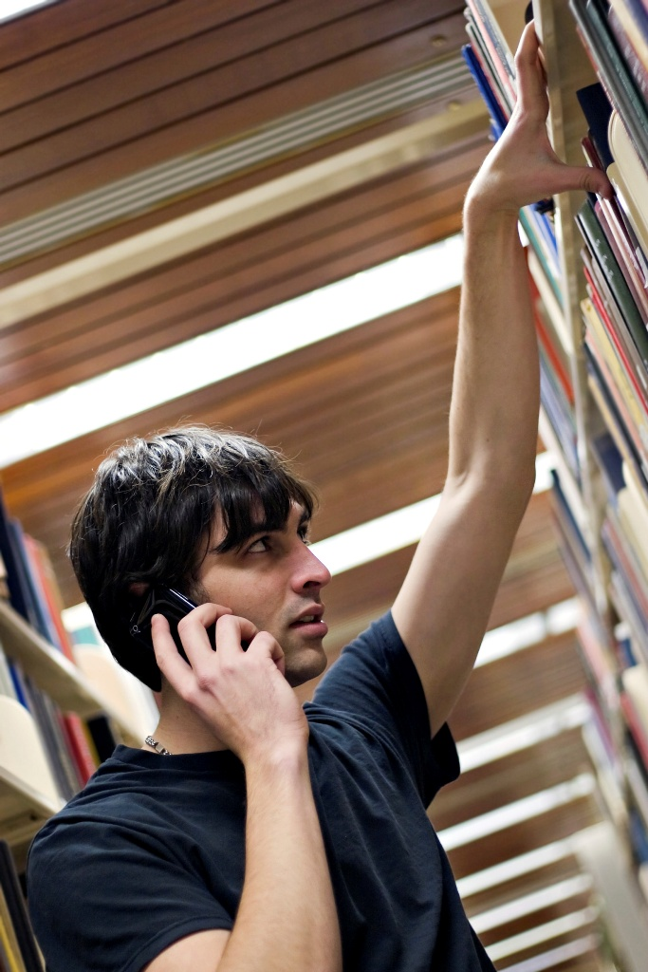
What are the implications of this level of cell phone use?
Notes:
Given the remarkably high level of cell phone use, we might well ask about how cell phone affect college students. Researchers point to several effects. (Also recall from the Chapter 6 presentation that Sherry Turkle found cell phone use correlated with a declining level of social empathy.)

Slide 4
…the lower the level of cardio-respiratory fitness among college students.
The greater the level of cell phone use…
Notes:
One consequence concerns physical health. Greater use of cell phones is correlated with a lower level of cardio-respiratory fitness. In short, researchers conclude, cell phone use discourages physical activity so that students are more sedentary.

Slide 5

In one study of introductory science classes, use of cell phones during class corresponded to a final grade drop of 1/3 of a grade point; another study puts it at 1/2 of a grade point.
A-
B+
Notes:
A second consequence involves academic performance. Specifically, cell phone use in class is linked to a lower final grade in the course (one-third to one-half of a grade point).
“Results show a significant negative correlation between in-class phone use and final grades, with use of cell phones corresponding to a drop of 0.36 (+/- 0.08) on a 4-point scale where 4.0 = A.” (Lepp, Barkley, & Karpinski, 2015)
“He is the co-author of a paper showing that, at his college, more than 75 percent of undergrads reported texting while in class, and that in-class texting was linked to an average drop of half a letter grade in the course.” (Kamanetz 2015)

Slide 6

“I usually go on my phone if I’m bored sitting there in class.”
“If I’m in class and I’m bored then I’ll use my phone to look on Facebook…”
“…I think it’s just kind of a habit now that I have, which probably isn’t a good one.”
“During homework I’ll take little Twitter breaks.”
Notes:
Students explain cell phone use as a response to boredom. Or is it that cell phones are more interesting than their college course material?

Slide 7
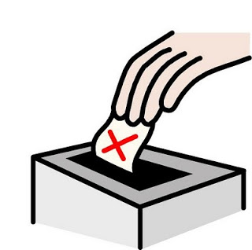
Professor Douglas Duncan asked students to vote on whether they should get “participation credit” for leaving their cell phones on his desk at the start of class.
“To my amazement the vote was unanimous. 100% voted yes. So they all took out their phones, put them on the desk, and we had an exceptionally engaged class."
Notes:
Many faculty feel that cell phone disrupt the classroom. Here is one strategy devised by Professor Douglas Duncan, Director of Astronomical Laboratories at the University of Colorado, Boulder.
"I asked two students on the way out why they voted to put their phones on the desk. They said, 'We know we aren't supposed to use them, and this gives us a reward for doing that.' “ – Dr. Duncan

Slide 8
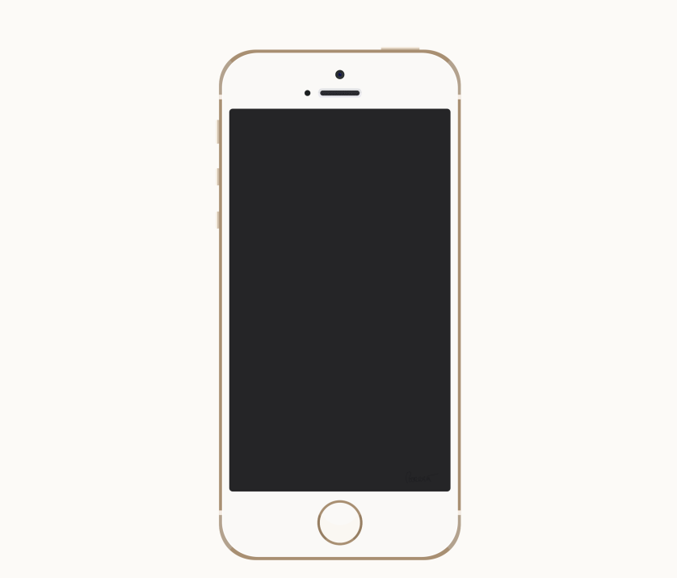
Other studies show that asking students to go an entire hour without checking their phones creates too much stress and anxiety, unduly distracting students.
In this case, the solution was to have one-minute “phone breaks” every 15 or 30 minutes.
Notes:
Here is another idea: the cell phone “break.”

Slide 9
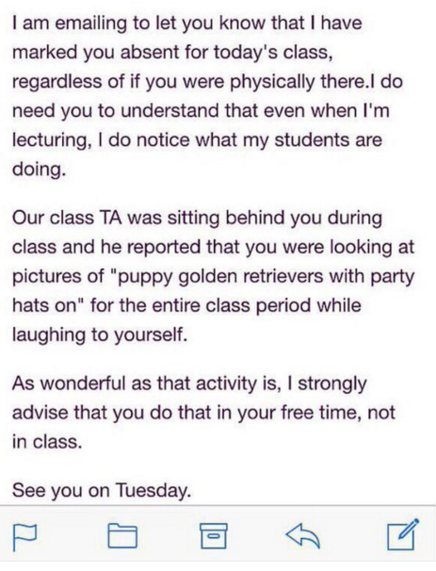
Here is a viral tweet that appeared in a Chronicle of Higher Education blog, purporting to be an email from a professor to a student.
Notes:
Ask the class whether or not professors should take offense at student use of cell phones in class.

Slide 10
Discussion Questions
What about you? Do you use a cell phone in class? To do what? Why?
Would you support strategies to ban or limit cell phone use in class? Why or why not?

