Slide 1
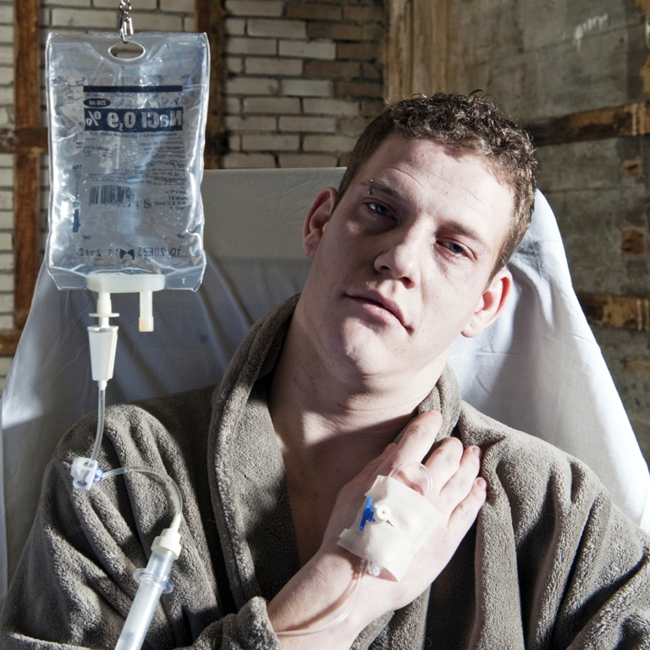
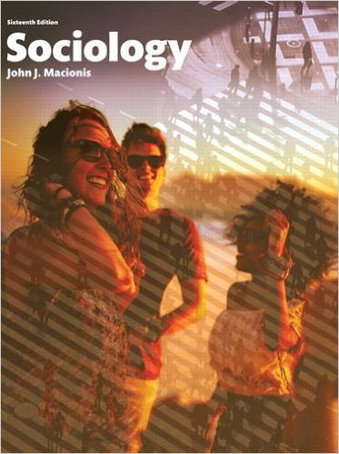
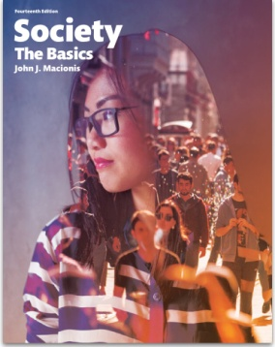
Increasing Midlife Mortality:
What Does it Say About U.S. Society?
Sociology
Chapter 21: Health and Medicine
Society: The Basics
Chapter 14: Education, Health, and Medicine
Notes:
Sources:
Case, Anne, and Angus Deaton. “Rising morbidity and mortality in midlife among white non-Hispanic Americans in the 21st century.” Proceedings of the National Academy of Sciences, Vol. 112, No. 49. September 17, 2015. http://www.pnas.org/content/112/49/15078
Kolata, Gina. “Death Rates Rising for Middle-Aged White Americans, Study Finds.” The New York Times, November 2, 2015. http://www.nytimes.com/2015/11/03/health/death-rates-rising-for-middle-aged-white-americans-study-finds.html
Economist’s View, “A Shocking Rise in White Death Rates in Midlife.” November 2, 2015. http://economistsview.typepad.com/economistsview/2015/11/a-shocking-rise-in-white-death-rates-in-midlife.html

Slide 2
Between 1970 and 2013, a combination of behavioral change, prevention, and treatment reduced mortality rates for people between the ages of 45 and 54 by 44%.
However, researchers Angus Deaton and Anne Case have uncovered a startling exception…
Notes:
Over recent decades, the overall health of the U.S. population has improved. But one troubling trend, involving non-Hispanic, middle-aged white people, is shown on the next slide.

Slide 3
Between 1999 and 2013, death rates among middle-aged non-Hispanic whites in the U.S. actually increased.
Notes:
The mortality rate among non-Hispanic, middle-aged, whites climbed about 9 percent between 1999 and 2013. Such patterns of declining health are unusual and demand an explanation.

Slide 4
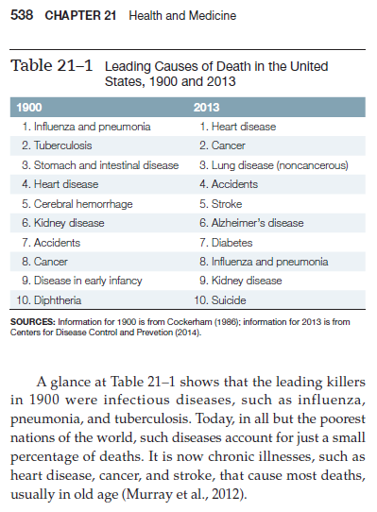
Professors Deaton and Case concluded that this increase was not due to heart disease or cancer, but rather to…
suicides,
alcoholic liver disease,
overdoses of heroin,
overuse of prescription opioids,
and…
Notes:
The increase in death rates for middle-aged whites is linked to behaviors that suggest people hold a pessimistic view of themselves and their future prospects.

Slide 5
…the increase was among non-Hispanic whites between 45 and 54 years old with no more than a high school education.
Notes:
The hypothesis linking rising mortality to a feeling of hopelessness is supported by the fact that this trend appears among middle-aged people with limited education. College-educated people of the same age show a decreasing death rate during the same time period. Note that, between 1999 and 2013, average income for middle-aged people with just a high-school diploma actually fell by almost 20 percent.

Slide 6

There was a corresponding increase of middle-age whites reporting they suffered from pain, from mental distress, had difficulty socializing, or were in poor health.
Notes:
Higher mortality in this category of the population is accompanied by increases in several troublesome patterns.

Slide 7
“It is difficult to find modern settings with survival losses of this magnitude.”
Ellen Meara and Jonathan S. Skinner,
Health researchers
“Only H.I.V./AIDS in contemporary times has done anything like this.”
Angus Deaton
co-author of the study and recipient of a 2015 Nobel Prize
Notes:
Researchers claim that the decline in health among less educated white people has no obvious parallels in the United States or elsewhere.

Slide 8
Discussion Questions
What do you think this research documenting increasing midlife mortality says about U.S. society?
In what ways does this research show that health is not simply a matter of science and medicine but also a reflection of how society operates?
Notes:
From Paul Starr at The American Prospect (11/2/15):
“The findings have important implications for American politics and public policy, particularly for debates about economic inequality, public health, drug policy, disability insurance, and retirement income. The data also suggest why much of American politics may be taking on an increasingly harsh and desperate quality.”

