Slide 1
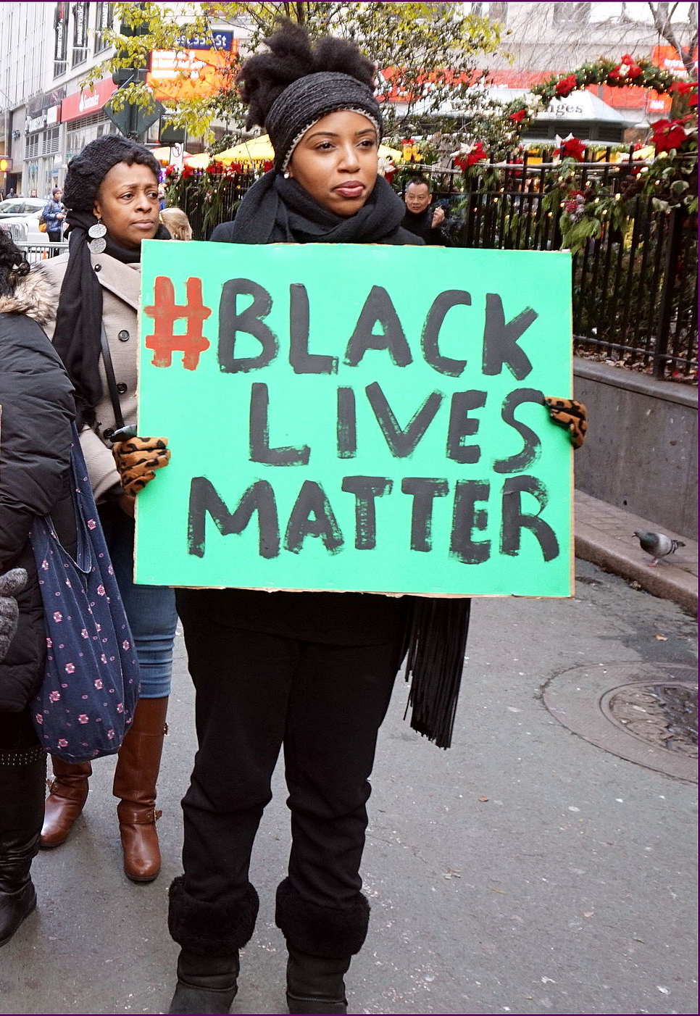
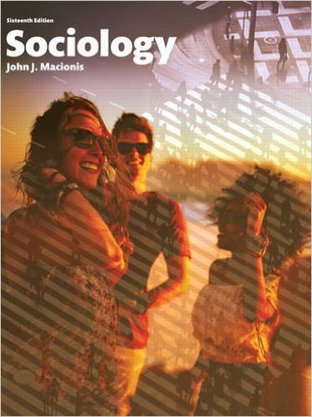
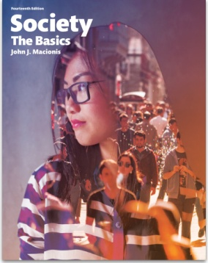
Social Movements and Social Media:
#BlackLivesMatter
Sociology
Chapter 23: Collective Behavior and Social Movements
Society: The Basics
Chapter 16: Social Change: Modern and Postmodern Societies
Notes:
Sources:
Altman, Alex. “The Person of the Year: The Short List No. 4, Black Lives Matter.” Time, December 16, 2015. http://time.com/time-person-of-the-year-2015-runner-up-black-lives-matter/
Chuck, Elizabeth. “#BlackLivesMatter: How a Hashtag Became a Digital Civil Rights Anthem.” NBC News, August 11, 2015. http://www.nbcnews.com/news/nbcblk/blacklivesmatter-how-hashtag-became-digital-civil-rights-anthem-n405316
The Economist, “What the Black Lives Matter campaign gets wrong.” August 18, 2015. http://www.economist.com/blogs/democracyinamerica/2015/08/race-and-criminal-justice
Morrison, Kimberlee. “2015’s Top 5 Social Activism Campaigns: #BlackLivesMatter, #LoveWins & More.” Adweek blog “Social Times.” December 28, 2015. http://www.adweek.com/socialtimes/2015s-top-5-social-activism-campaigns-blacklivesmatter-lovewins-more/632051
Ruffin, Herbert. “Black Lives Matter: The Growth of a New Social Justice Movement.” 2015. http://www.blackpast.org/perspectives/black-lives-matter-growth-new-social-justice-movement
Photo here: by The All-Nite Images [CC BY-SA 2.0 (http://creativecommons.org/licenses/by-sa/2.0)]

Slide 2
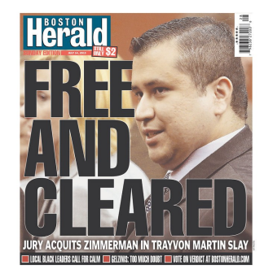
In July, 2013, a jury in Florida acquitted neighborhood watch coordinator George Zimmerman in the killing of 17-year-old Trayvon Martin.
Notes:
The 2012 killing of Trayvon Martin sparked concerns about violence directed at African Americans. This situation became inflamed when the shooter was found not guilty of second-degree murder and manslaughter a year later. The social movement “Black Lives Matter” was about to be born.

Slide 3
Alicia Garza, a community organizer in Oakland, California reacted with a Facebook post that ended “Our Lives Matter, Black Lives Matter.”
Patrice Cullors, an anti-police violence organizer in Los Angeles responded with the hashtag #BlackLivesMatter.
In Phoenix, immigration rights organizer Opel Tometi added her support.
Notes:
Social movements typically arise through the action of concerned individuals. The movement may spread more rapidly if the issue is of concern to many people and if there is a clear symbol of the movement—in this case, the phrase “Black Lives Matter.”
The individuals identified here were instrumental in launching the social movement “Black Lives Matter.”

Slide 4
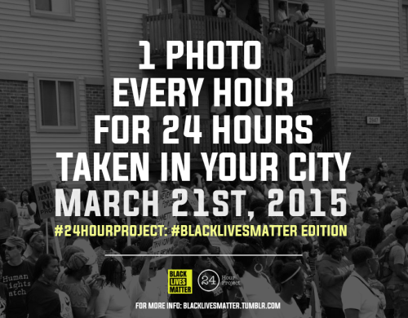
Black Lives Matter was born.
Using Facebook, Twitter, and Tumblr, these three women created a movement unlike most black freedom campaigns that preceded them.
Notes:
Note the power of social media to greatly extend the reach of any social movement. The widespread networks supported by social media also made social movements less “top down” and more democratic.

Slide 5
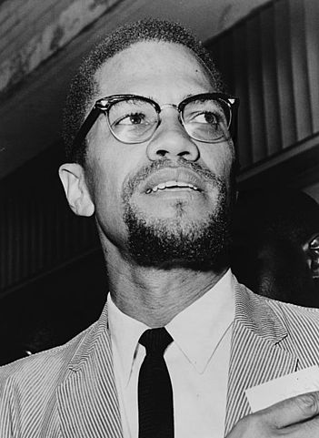
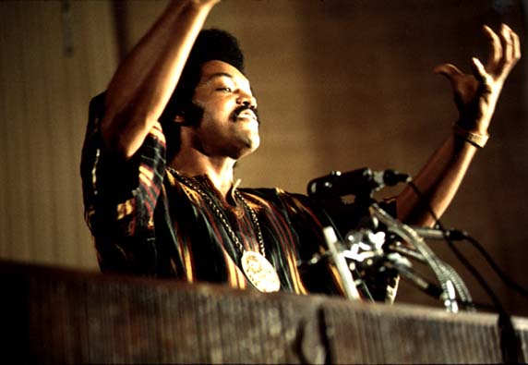
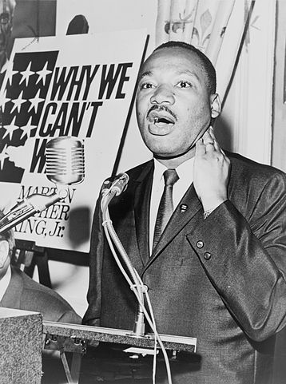
“ …they used newly developed social media to reach thousands of like-minded people across the nation quickly to create a black social justice movement that rejected the charismatic male-centered, top-down movement structure that had been the model for most previous efforts. “
Herbert G. Ruffin II, Associate Professor of African American Studies at Syracuse University
Notes:
Photos in Public Domain:
(1) "Martin Luther King Jr NYWTS 4" by New York World-Telegram and the Sun staff photographer: Albertin, Walter, photographer. - Library of Congress Prints and Photographs Division. New York World-Telegram and the Sun Newspaper Photograph Collection. http://hdl.loc.gov/loc.pnp/cph.3c22985. Licensed under Public Domain via Commons.
(2) Jesse Jackson photo by John H. White. ID# (NWDNS-412-DA-13800) Via Archives.gov
(3) Malcolm X photo by Herman Hiller, World Telegram staff photographer - Library of Congress. New York World-Telegram & Sun Collection. http://hdl.loc.gov/loc.pnp/cph.3c11166

Slide 6
#BlackLivesMatter was tweeted 9 million times in 2015.
Notes:
Other social movements that were expanded by social media involved Caitlyn Jenner and the transsexual movement and the movement that led to the legalization of same-sex marriage.

Slide 7
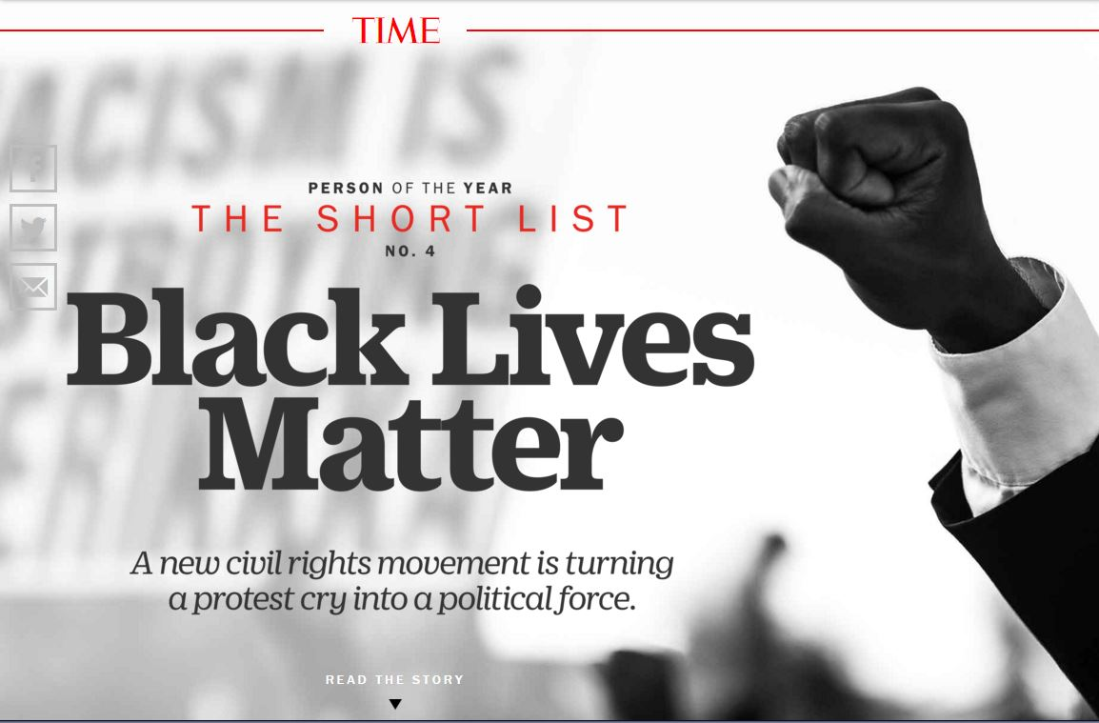
“In 2015, Black Lives Matter blossomed from a protest cry into a genuine political force.” Time, December 14, 2015
Notes:
Also from Time: “As a slogan, ‘Black Lives Matter’ is a piece of linguistic jujitsu, vague enough to seem inclusive yet charged enough to sow conflict.”

Slide 8
Discussion Questions
In what ways do social media change the character of social movements?
Can you point to other social movements that have successfully made use of social media?

